Slide 1

HMIS ADVISORY
COMMITTEE MEETING
Central Florida Commission on Homelessness (CFCH) - FL-507
Sept 8th, 2026

Slide 2
HMIS Advisory Committee Mission
Our mission is to effectively use data, which includes
inputs from those in need of services, those providing
services, and from members of the community, to
eliminate homelessness in Central Florida.
HMIS Advisory Committee Purpose
Oversee the CoC’s implementation of HMIS, what we do with the data and how we use it.​

Slide 3
HMIS Advisory Committee Members
Committee Chair | Karen Jackson | Zebra Youth
Co-Chair | Denise Major | Salvation Army
Voting Member | Sabrina Weier | SALT Outreach
Voting Member | Danny Arroyo | Pathlight Home
HMIS Team Liaison | Brittney Behr | Homeless Services Network

Slide 4
AGENDA
HMIS Recommendations for New Agency Participation
Data Scorecard Updates - Error Upgrade to High Priority
Vendor Satisfaction Survey - What Questions Should We Include?
Merging Duplicates That Are Not Reported - Next Steps
Adding a Pet Assessment - Feedback
Case Note Reporting - How To Enter Data That Supports Reporting
New Feature Utilization: Bar Codes
HMIS Training Reminders
Next Meeting - Dec 8th, 2026
1
2
3
4
5
6
7
8
9

Slide 5
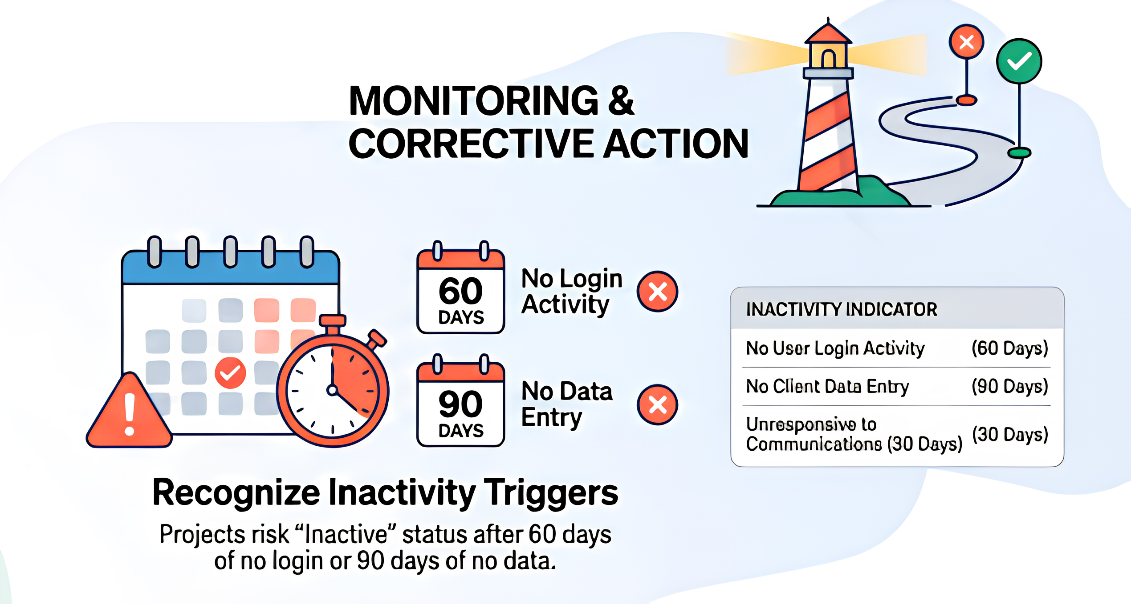
HMIS Recommendations for New Agency Participation

Slide 6

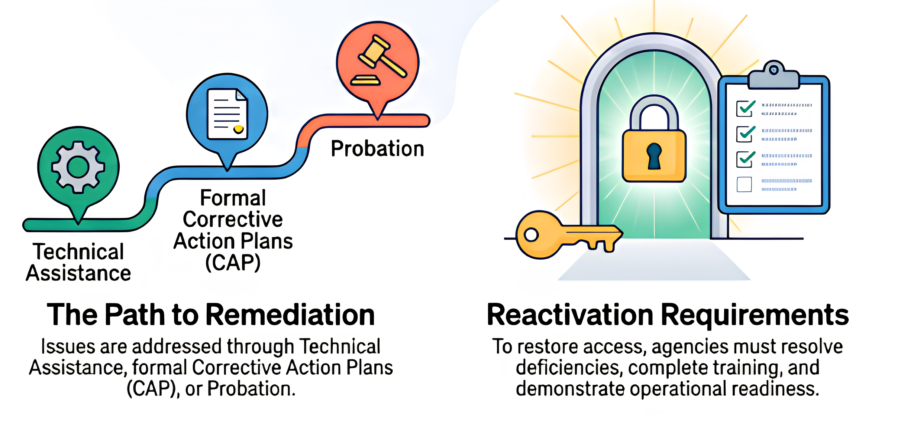
HMIS Recommendations for New Agency Participation

Slide 7


Data Scorecard Updates - Error Upgrade to High Priority
We have been using the Data Quality Scorecard for 1 year!
  After reviewing a year’s worth of data, the HMIS team would like to recommend one change to grading:
    Currently, Missing Enrollment CoC is considered a Completeness Error (worth 20% of the grade)
    Starting 10/01/2026, Missing Enrollment CoC will be considered a High Priority Issue (worth 50% of the grade)
Why make this change?
  Missing Enrollment CoC is a required field that is auto-populated by ClientTrack whenever an intake is completed. If the Enrollment CoC value is missing, it means one of two things:
    The enrollment was canceled and left uncompleted, meaning no data was collected at all (most common reason)
    The entry assessment is not correctly connected to the enrollment - this can be fixed with admin assistance when we are notified
  By upgrading the error to High Priority, we want to encourage people to focus on completeing the full assessment and review any records left incomplete - incomplete assessments can impact our ability to understand the homeless population’s needs and eligibility for programs, including programs outside of CoC-Funded housing.

Slide 8

Vendor Satisfaction Survey - What Questions Should We Include?
Breakout Rooms
  After a few years with the vendor Caseworthy, we want to understand how users feel about ClientTrack
  What questions should we include?
    Breakout Rooms Discussion
    HMIS Staff will take notes
Areas to consider:
  Experiences with creating intakes - family set-up, enrollment creation, updating and exiting
  Experiences with reporting capabilities
  Experiences with training - how hard is it to learn how to use ClientTrack?
  And anything else you think is important!

Slide 9

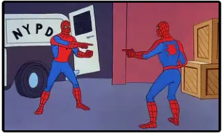
Merging Duplicates That Are Not Reported - Next Steps
Gratitude
  We want to thank all of you that have found and reported duplicate clients using the Zendesk support tickets!
  It is very important that everyone continues to do a thorough search before adding a new client to the system. And as you find potential duplicates, please continue to submit them for merging via Zendesk (hmis@hsncfl.org or on the hmiscfl.org website).
Hidden Duplicates
  As of August 2026, we have identified 453 unreported, potentially duplicate clients; which include 142 with open enrollments and a few (58) are duplicates within the same agency.
Plan of Action
  We will coach agencies on how to identify and resolve duplicates that they have created using the Duplicated Clients standard report,
  For cross-agency duplicates, the HMIS team will by reaching out to both parties involved to notify them of pending merges.

Slide 10

Adding a Pet Assessment - Feedback
Suggested Questions
These are questions that can be added as an additional assessment in ClientTrack to help with documentation of participants that have pets to better understand their needs.
1. Do you have any pets? (yes/no) - if "yes", additional questions display
a. How many? (# select list)
b. Are any of your pets a service animal? (yes/no)
2. List the type of pets you have (describe breed for dogs) (open text boxes)
Additional possible question
3. Is your pet(s) house trained?
4. Is there a family member or friend that can keep your pet(s) for a period of time?

Slide 11
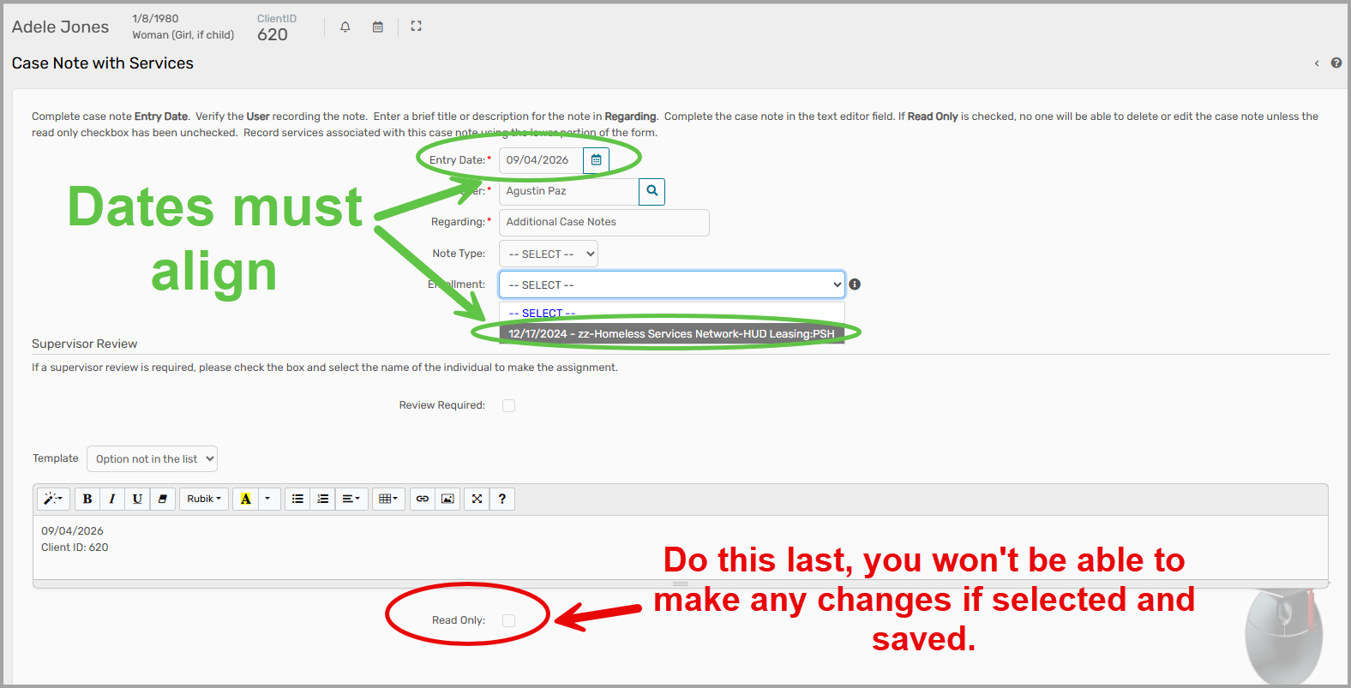
Case Note Reporting - How To Enter Data That Supports Reporting
Associating Case Notes with Project Enrollments

Slide 12
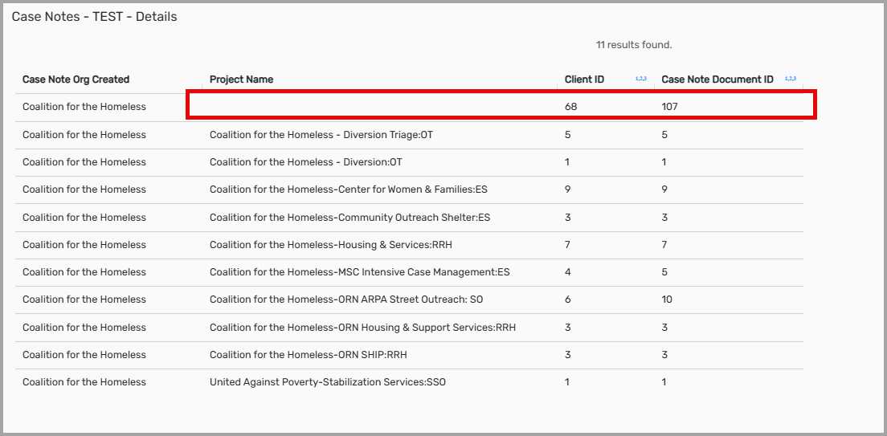
Case Note Reporting - How To Enter Data That Supports Reporting
Associating Case Notes with Project Enrollments

Slide 13

New Feature Utilization: Bar Codes
What is this?
A way to quickly capture services provided at agencies
What might this look like?
  Program participants are issued an ID with a barcode tied to their HMIS record.
  Services at an agency will have associated barcodes.
  PP identification is scanned and the service is scanned. Service appears in HMIS.

Slide 14
HMIS Training Reminders
Our routine monthly training calendar:​
1st & 3rd Tuesday: HMIS 101 New User Training (9a - 2p)​
By Ticket Request: HMIS 101/102 Refreshers (2p - 4p)​
3rd Tuesday: ClientTrack Introduction to Reports Training (3p - 4:30p)​
​
Ad-Hoc Reports Training (request via HMIS Support Ticket)​
APR/CAPER in ClientTrack​
Everyday Reporting in ClientTrack ​
Explore Data Explorer​
Data Quality Workshop​
​
Join us for our office hours M/W from 1p - 2p for additional one-on-one HMIS support.​
https://zoom.us/j/97407205687
Reminders: ​
All new user training requests must come through the Agency Liaison.​
Agency Liaison needs to let the HMIS team know ASAP when someone leaves​
the agency so we can inactivate accounts.
This is to keep an accurate count of subscriptions for assignment.

Slide 15
Any Motions For Committee Vote

Slide 16
HSN HMIS Team
Angel Jones​
Director of Information Systems​
​
Agustin “Tino” Paz​
HMIS Senior Data Analyst​
​
Brittney Behr​
HMIS Data Analyst I
Racquel McGlashen​
HMIS System Administrator​
Tim Reed​
HMIS Partner Success Specialist​
​
Gregory Carter​
HMIS Partner Success Specialist​
​

Slide 17
Thank you for joining us!
Next Meeting - Dec 8th, 2026 at 10:30am

