Slide 1

HMIS ADVISORY
COMMITTEE MEETING
Central Florida Commission on Homelessness (CFCH) - FL-507
March 10th, 2026

Slide 2
HMIS Advisory Committee Mission
Our mission is to effectively use data, which includes
inputs from those in need of services, those providing
services, and from members of the community, to
eliminate homelessness in Central Florida.
HMIS Advisory Committee Purpose
Oversee the CoC’s implementation of HMIS, what we do with the data and how we use it.​

Slide 3
HMIS Advisory Committee Members
Committee Chair | Karen Jackson | Zebra Youth
Co-Chair | Denise Major | Salvation Army
Voting Member | Juan Correa | Transition House
Voting Member | Sabrina Weier | SALT Outreach
Voting Member | Danny Arroyo | Pathlight Home
HMIS Team Liaison | Brittney Behr | Homeless Services Network

Slide 4
AGENDA
Longidutinal Systems Analysis (LSA) - Stella and Data Quality Review
System Performance Measures (SPM) Overview
Point-in-Time Count (PIT) and Housing Inventory Count (HIC) Needs
Deceased Workflow - How to Resolve Issues
Duplicate Clients - How to Manage
HMIS Training Reminders
Any Motions For Committee Vote
Next Meeting - May 12th, 2026
1
2
3
4
5
6
7
8

Slide 5
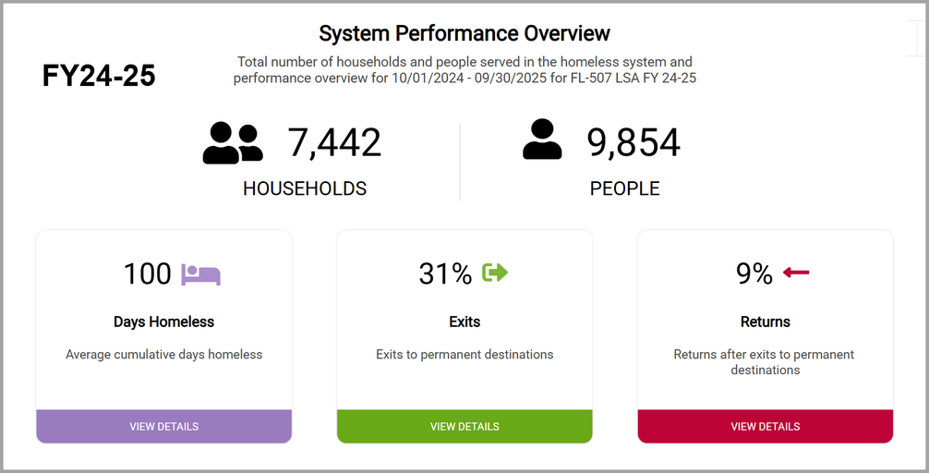
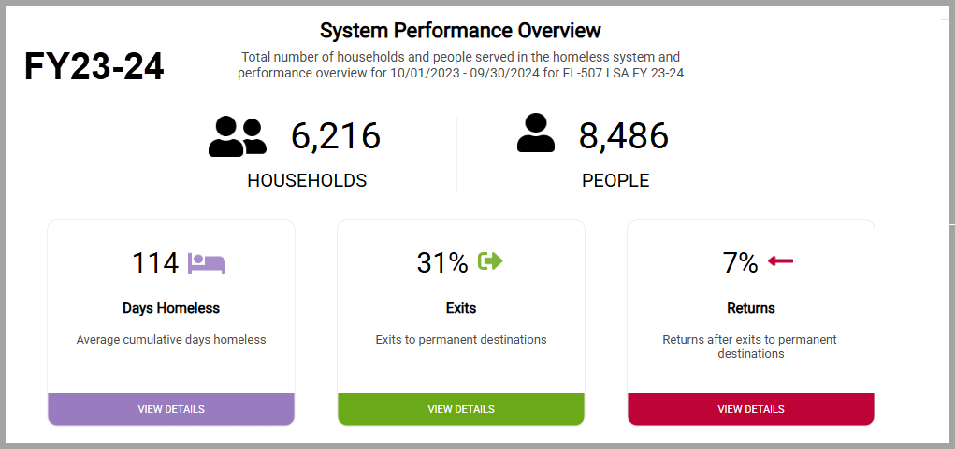
Longidutinal Systems Analysis (LSA) - Stella and Data Quality Review
Current Year Submission
Last Year Submission
Let’s jump into to FY24-25 together!

Slide 6
Longidutinal Systems Analysis (LSA) - Stella and Data Quality Review
LSA Warning Flags Unable to Be Resolved by Report Date:
Missing Disability Status
Missing Race/Ethnicity values
Missing Domestic Violence values
Missing Prior Living Situations
Missing Exit Destinations
The Data Quality Scorecard and APR/CAPER can be used to clean up missing data.
If you would like to meet one-on-one abut scorecard data, please submit a ticket and let us know!
Thank you to everyone who contributed data to the LSA.
Your attention to the quality of the data makes an impact, and the fact that we had so few warning flags is a result.

Slide 7
System Performance Measures (SPM) Overview
1
Length of Time Homeless
4
Income Growth for PSH/RRH
ES & TH: 86.5 days average
Stayers: 35% increased income
ES, TH & PH: 469 days average
Leavers: 22.5% increased income
2
Returns to Homelessness
5
Number of People First-Time Homeless
ES: 28% returned
ES & TH: 4389 (78%) were homeless for the first time
TH: 15% returned
SO: 22% returned
ES, TH & PH: 5740 (75.5%) were homeless for the first time
PH: 16% returned
3
Number of People Homeless
7
Exits to Permanent Housing
6474 people served
  5630 in ES
  932 in TH
SO: 69% exited to permanent housing or shelter
ES, TH & RRH: 40% exited to permanent housing
PSH: 97% retained permanent housing
HDX report live on the HMIS website

Slide 8
Point-in-Time Count (PIT) and Housing Inventory Count (HIC) Reminders
  Please respond ASAP to any inquiries about:
    Missing data for sheltered people
    Confirming number of people enrolled in shelter and transitional housing
    Confirming entry of all Housing Move-in Dates
    Updating bed inventories and fund source end dates
No due date has been announced by HUD for the PIT/HIC as of this meeting.

Slide 9
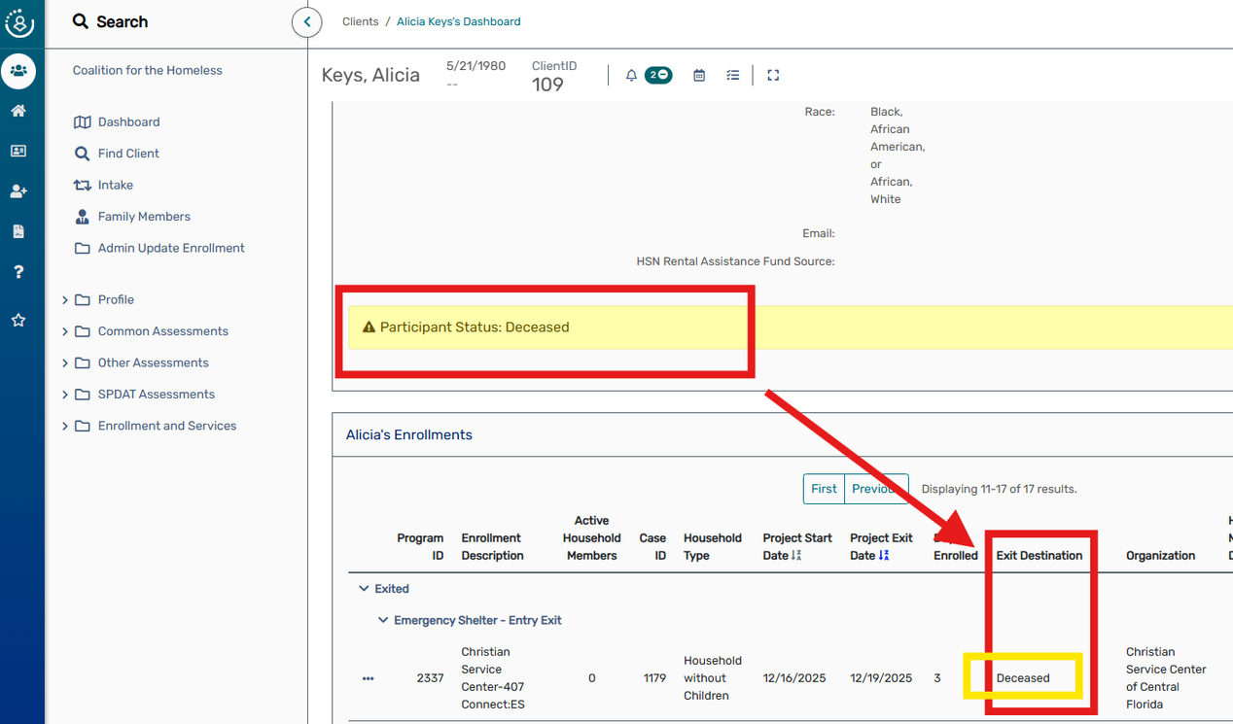
Deceased Workflow - How to Resolve Issues
How is the “Client Status: Deceased” notification triggered on a client’s dashboard?
  There is an enrollment with an exit destination selected as “Deceased”.
What should I do if the program participant is not actually deceased?
  Check the enrollment to see who the creating agency/user is for the “deceased” and connect with them to update the exit destination OR
  Submit a support ticket to the HMIS team for us to assist with reaching out for the update to be made.

Slide 10

Duplicate Clients - How to Manage
Why Reducing Duplicates Matter
We want to make sure that the work of so many people, now close to 500 users, is as reliable as possible as one of the most important sources of truth about homelessness in our community.​
​
The nature of so many people collectively working together to address the challenges of people experiencing homelessness occasionally results in creating more than one record for the same person.​
​
We are committed to minimizing the creation of duplicates as well as the resolving as quickly as possible.

Slide 11

What is a duplicate in HMIS?
You ever walked around minding your business and then have your pinky toe meet the corner of a sturdy, well-aged piece of furniture?​
​
Ever step on a Lego? Find your favorite carpet or shirt with last night’s leftover slime embedded to the point of no return? ​
​
That’s a duplicate. A huge pain in our system’s technical backend.​
​
On a serious note, it is another instance of a client record in our system, typically created via user entry error.

Slide 12

System Challenges
CAUSES​
  User data entry errors (controllable)​
  When the visibility of the original record has been“ locked down” at the request of the program participant (uncontrollable)​
  ​
IMPACT on the SYSTEM​
  Skews data analysis​
  Creates inconsistencies in data integrity​
  Prevents an agency from being able to see the entire“ story”

Slide 13

What can we do about it?
ClientTrack has triggers built in that appear as reminders or pop-up notifications when adding a client to the system. Take the time to look and compare potential matches before moving forward with creating a new client!​
​
  Use the client search form first to see if the client already exists before starting a new intake.​
  When doing the new intake, the system will also remind you to check the list of potential matches.

Slide 14

A Positive Impact
  Improved data accuracy and integrity
  Enhanced operational efficiency
  Better customer experience
  Improved decision-making
  Enhanced security and compliance

Slide 15
HMIS Training Reminders
Our routine monthly training calendar:​
1st & 3rd Tuesday: HMIS 101 New User Training (9a - 2p)​
2nd & 4th Wednesday: HMIS 101/102 Refreshers (2p - 4p)​
3rd Tuesday: ClientTrack Introduction to Reports Training (3p - 4:30p)​
​
Ad-Hoc Reports Training (request via HMIS Support Ticket)​
APR/CAPER in ClientTrack​
Everyday Reporting in ClientTrack ​
Explore Data Explorer​
Data Quality Workshop​
​
Join us for our office hours M/W from 1p - 2p for additional one-on-one HMIS support.​
https://zoom.us/j/97407205687
Reminders: ​
All new user training requests must come through the Agency Liaison.​
Agency Liaison needs to let the HMIS team know ASAP when someone leaves​
the agency so we can inactivate accounts.
This is to keep an accurate count of subscriptions for assignment.

Slide 16
Any Motions For Committee Vote

Slide 17
HSN HMIS Team
Angel Jones​
Director of Information Systems ​
​
Racquel McGlashen​
HMIS System Administrator​
​
Agustin “Tino” Paz​
HMIS Senior Data Analyst​
​
Brittney Behr​
HMIS Data Analyst I
Tim Reed​
HMIS Partner Success Specialist​
​
Gregory Carter​
HMIS Partner Success Specialist​
​
Moesha Herron​
HMIS Partner Success Specialist

Slide 18
Thank you for joining us!
Next Meeting - May 12th, 2026 at 10:30am

