Slide 1

Salesforce Strategic Plan
Recommendations & Roadmap
Prepared for:
Angel Jones, HMIS Operations Manager
Proprietary and Confidential

Slide 2
Our Process
Reverse demo of current environment
Discovery Meeting(s) with Angel
  Organization goals
  Organization challenges
  Business process at a high-level
  Data architecture – Salesforce vs Excel spreadsheets
  Software architecture
  Organization structure needs and responsibilities
Salesforce Audit
Strategic Recommendations & Roadmap
Next Steps

Slide 3
Organization Goals
Company goals provided by HSN
  Top-rated service responds to customer needs quickly
  Clear, functional operating systems
  Integrated voices of persons with lived experience
  Increased social media presence
  Improved CFCH website and linkage to HSN website

Slide 4







Potential Key Performance Indicators
Each department can influence these key outcomes.
Improve service quality
Increase operational efficiency
Foster team collaboration
Streamline core processes
Drive community impact
Strategic & Long
Term Homelessness
Donor Engagement & Retention
Funding, Accountability & Sustainability
150
Additional Families Housed
2000
New Donors
100%
Audit Score
75
Kids Enrolled in School
900
New Sustaining Members
7
New Donor Advised Funds
25%
Decrease in City Spending
88%
Donor Retention Rate
15%
Decrease in G&A Expenses
Communications / Outreach
Finance &
Operations
Volunteer Engagement & Support
Grants & Advancement
250%
Campaign ROI
42%
Increase in Program Efficiency
92%
5-Year Volunteer Retention Rate
46
New Grants Secured
28
Min/ Touches of Each Donor / Year
23%
Improvement in Overhead Rate
98%
Volunteer Satisfaction
10%
Increase in Average Grant Size
75%
Donation Conversion Rate
12%
Drop in Cost per Dollar Raised
12%
Drop in Cost per Dollar Raised
32%
Increase in Non-Donation Revenue
Metrics are not actual. For presentation only

Slide 5
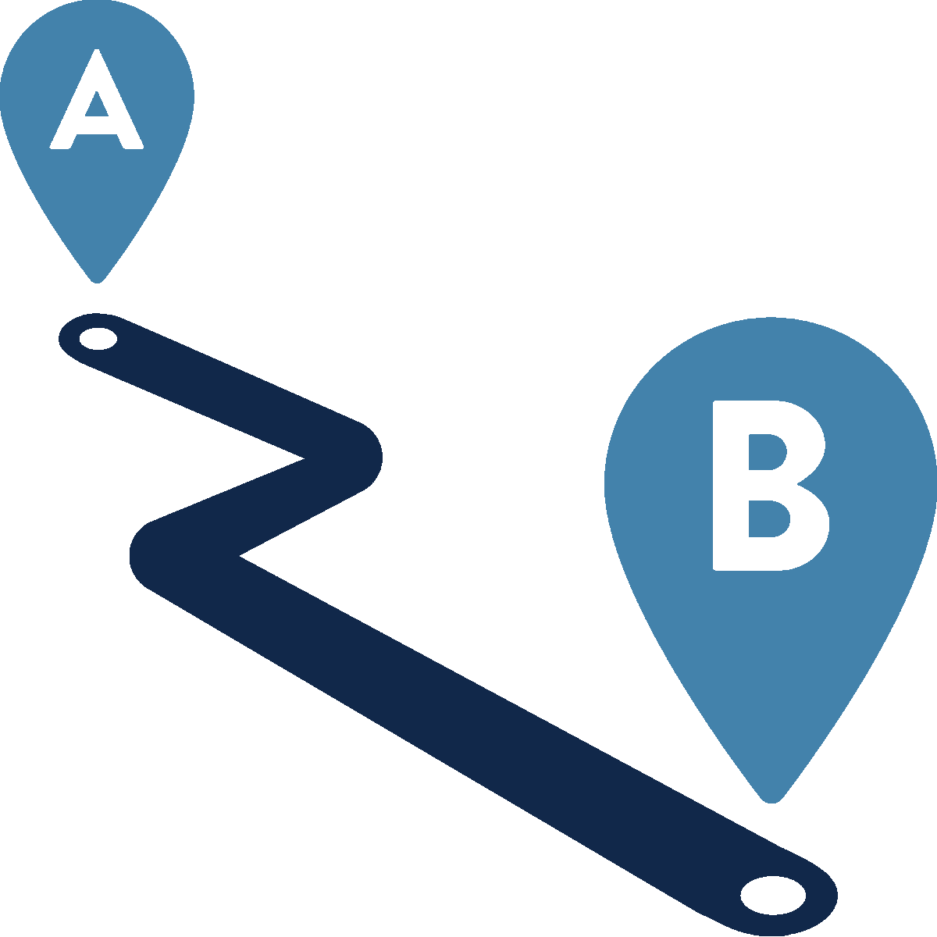


Salesforce Goal:
Grow Your Business By Maximizing Your Salesforce Investment
Challenge: | Scalability You need to reduce non-value add and silo approach in the business process. | Resource Efficiency You need resources allocated when they are needed to optimize efficiency and minimize waste. | Integrated Collaboration You need to share information, resources, and expertise across different functions. | Leverage Solution You need to support the scale to new business on a single platform.
Consequence: | High-Cost Growth You could continue inefficiencies, higher costs hindering growth. | Increased Costs You see increased costs, reduced efficiency, and poor client service hindering overall business performance. | Disjointed Operations You could continue with silos, excel spreadsheets, communication barriers, duplication, delays and poor customer experience. | Separate Solutions You could end up with business growth be constrained by limited capacity or complexity
Solution: | Automated Approach Build triggers and rules which take manual work out of the solution | JIT Workload Mgmt. Enable users to swiftly access pertinent information and customize workflows for dynamic demands. | Unified Communication Engage a team that has worked in industry, not just consulted | Versatile Platform Flexible platform adaptable to diverse business requirements

Slide 6
Salesforce Goal:
Grow Your Business By Maximizing Your Salesforce Investment
Challenge: | Reporting You need an environment which fosters data accuracy, accessibility, transparency, and collaboration through reporting.
Consequence: | Inadequate Reporting You continue uninformed decision-making, missed opportunities, and reduced operational efficiency.
Solution: | Insightful Reporting Integrated data, customizable dashboards to ensure accuracy for informed decision-making.

Slide 7
Assessment Findings Summary
Salesforce delivers very little and isn’t configured to support core operations.
Daily activities are not well defined and not tied to mission outcomes.
Departmental silos create Isolated systems which limit collaboration and visibility.
Business functions do not appear to follow clearly defined or standardized processes.
Disconnected data from HMIS and Excel makes reporting and insights difficult.
A structured plan for expanding donor relationships is still emerging.
Lack of external integration causes inefficiencies and fragmented workflows.
Missed opportunities to boost efficiency and engagement due to lack of Salesforce features use.
55 different software products some duplicate - adds confusion and inefficiency.
It is not clear that consistent tracking of key performance indicators is currently in place.

Slide 8
Recommendation Summary
Integrate Data Architecture for Business Visibility
Standardize and Streamline Core Business Processes
Configure Salesforce to Reflect How the Organization Actually Operates
Leverage new donor development expertise to guide NPSP setup
Align Daily Staff Activities with Mission Goals
Maximizing Operational Efficiency by Expanding Salesforce Adoption
Foster Cross-Department Collaboration and Visibility
Eliminate Redundant Software and Standardize Tools
Notes:
Evaluate how different departments use Salesforce and identify underutilized features that could support fundraising, programs, volunteer management, and outreach.
Consolidate core operational tasks—such as case management, event coordination, communications, and impact reporting—into Salesforce for greater visibility and efficiency.
Use Salesforce tools like flows, alerts, and task automation to streamline operations across departments and reduce manual effort.
Offer targeted training to help all teams use Salesforce effectively for their specific responsibilities, driving consistent adoption and collaboration.

Slide 9
Detailed Recommendations
Integrate Data Architecture for Business Visibility
  Centralize operations in Salesforce by integrating data from external systems and spreadsheets for real-time visibility.
  Retain specialized tools while syncing relevant data to Salesforce through APIs or ETL processes.
  Implement a unified data layer to standardize and consolidate data for consistent analytics and reporting.
  Deliver role-based dashboards in Salesforce or BI tools to support informed decision-making across business processes.

Slide 10
Detailed Recommendations
Standardize and Streamline Core Business Processes
  Identify and document the most important workflows across departments
  Build these standardized processes into Salesforce to ensure consistency
  Train staff on these procedures to reduce confusion and improve efficiency
  Review processes regularly and update them as the organization evolves
Configure Salesforce to Reflect How the Organization Actually Operates
  Conduct a review of how Salesforce is currently used vs. how work happens
  Simplify process and configure Salesforce to support real workflows, not legacy setups
  Tailor the platform to user needs by removing clutter and aligning with job roles
  Make Salesforce a helpful, intuitive tool that supports — not slows down — daily work

Slide 11
Detailed Recommendations
Leverage new donor development expertise to guide NPSP setup.
  Use NPSP to map and automate key donor lifecycle stages—from first-time gift to major giving—ensuring consistent engagement and stewardship practices.
  Consolidate donor interactions, preferences, and giving history in Salesforce to enable personalized outreach and informed decision-making across fundraising teams.
  Configure user roles and workflows in Salesforce to support clear ownership of donor development tasks, reducing overlap and ensuring accountability.
  Build real-time dashboards to track donor pipeline progress, retention metrics, and engagement activity, enabling data-driven adjustments to the donor growth strategy.

Slide 12
Detailed Recommendations
Align Daily Staff Activities with Mission Goals
  Clarify which daily tasks contribute directly to your mission and impact
  Ensure those tasks are easily tracked and managed within Salesforce
  Provide staff with tools and guidance to complete key activities consistently
  Use reports and dashboards to measure how daily work supports broader goals
Maximizing Operational Efficiency by Expanding Salesforce Adoption
  Evaluate how different departments use Salesforce and identify underutilized features that could support fundraising, programs, volunteer management, and outreach.
  Consolidate core operational tasks—such as case management, event coordination, communications, and impact reporting—into Salesforce for greater visibility and efficiency.
  Use Salesforce tools like flows, alerts, and task automation to streamline operations across departments and reduce manual effort.
  Offer targeted training to help all teams use Salesforce effectively for their specific responsibilities, driving consistent adoption and collaboration.

Slide 13
Detailed Recommendations
Foster Cross-Department Collaboration and Visibility
  Create a shared Salesforce setup that supports data and communication across all departments
  Define how teams should share information and coordinate efforts within the platform
  Develop shared dashboards and reports to increase transparency and alignment
  Hold regular cross-functional reviews to ensure collaboration and accountability
Eliminate Redundant Software and Standardize Tools
  Leverage the organization-wide software review conducted by Angel to identify overlapping tools serving similar purposes.
  Select and standardize a core set of approved tools that meet most business needs and integrate well with Salesforce when appropriate
  Develop clear guidelines on which tools should be used for specific functions
  Provide training and support to ensure all staff transition smoothly to the standardized tools
  Establish an approval process for new software to maintain consistency

Slide 14



A 4-Phase Roadmap to Value
1
Discovery & Alignment for a dept.
Understand current usage, identify gaps, and align leadership
KICKOFF
Design & Standardization
Streamline tools and processes across departments
2
Repeat
By Department
Configure, Align & Maximize
  Establish clear process, Mission goals, Create efficiency & Collaboration
3
Training & Change Enablement
Streamline tools and processes across departments
4
LAUNCH

Slide 15
Suggested Timeline
Timeline can expand and contract or move at a pace that meets the organization capabilities for change and business objectives.
MEDIUM-TERM WINS
Ongoing Enhancements
Continue Operational efficiency & Collaboration
Standardize and streamline Donor and 1st priority department
Standardize and streamline remaining departments core processes
Setup
Integrated clean data, streamlined processes, expanded adoption organization-wide.
PHASE 0
PHASE 2
PHASE 4
THE FUTURE
MONTH
1 | 2 | 3 | 4 | 5 | 6 | 7 | 8 | 9 | 10 | 11 | 12 | 13 | 14 | 15 | 16 | 17 | 18 | 19 | 24
Foundation and Setup
PHASE 3
Continue operational efficiency, expand adoption and complete remaining departments
Discovery & Foundation Design, Configuration, Architecture Buildout & Data Prep
Process Optimization & Role-Based Configuration
Eliminate and Standardize software usage
Integrate external and clean-up internal Salesforce data
PHASE 5
EARLY PROJECT WINS
LONG-TERM
WINS
Optimized systems, streamlined processes, for 2 priority including donor operations for clear ROI
Expanded capabilities to maximize donor and constituent impact in communities
Proprietary and Confidential

Slide 16
What is need from you…
Executive sponsorship with leadership backing, budget, and strategic oversight.
Engagement with a consulting partner to apply expertise and best practices.
Use this Strategic Plan as a clear vision and goals aligned with business strategy.
Allocate resources for Subject Matter Experts from departments.
Discuss and define a scope of the overall architecture goals
Active participation from all departments for requirements and decisions.
Support optimized processes, clean data, integrated systems, and apply change management with training and adoption strategies for each department.
Monitor a continuous improvement approach using feedback and analytics.
Measure implementation results to show ROI and build confidence for the next department’s rollout.

Slide 17
Potential Key Performance Indicators
Each department can influence these key outcomes.
Improve service quality
Increase operational efficiency
Foster team collaboration
Streamline core processes
Drive community impact
Strategic & Long
Term Homelessness
Donor Engagement & Retention
Funding, Accountability & Sustainability
150
Additional Families Housed
2000
New Donors
100%
Audit Score
75
Kids Enrolled in School
900
New Sustaining Members
7
New Donor Advised Funds
25%
Decrease in City Spending
88%
Donor Retention Rate
15%
Decrease in G&A Expenses
Communications / Outreach
Finance &
Operations
Volunteer Engagement & Support
Grants & Advancement
250%
Campaign ROI
42%
Increase in Program Efficiency
92%
5-Year Volunteer Retention Rate
46
New Grants Secured
28
Min/ Touches of Each Donor / Year
23%
Improvement in Overhead Rate
98%
Volunteer Satisfaction
10%
Increase in Average Grant Size
75%
Donation Conversion Rate
12%
Drop in Cost per Dollar Raised
12%
Drop in Cost per Dollar Raised
32%
Increase in Non-Donation Revenue

Slide 18
What might it cost?
Depends on defined requirements and priorities
Scope spans multiple departments and is perceived to be mid-high complexity
Exact cost can’t be determined until discovery is completed
  Process: clarify objectives → gather requirements → define scope → estimate cost
Final cost will depend on HSN specific scope
  Speed of work and pace of the project can help spread the cost over time
Similar projects* have ranged from:
  Discovery $7,400 - $16,000
  Implementation⁺ $50,000 - $105,000
  On-going Support⁺⁺ TBD
* Estimates based on comparison with other customer engagement complexity
⁺ Implementation costs can be spread over time but will delay ROI due to expanded timeline
⁺⁺ HSN Organization evolves and scales over time based on opportunities and business needs so some sort of budget will be needed for on-going adjustments of Salesforce

Slide 19


Questions?

