Slide 1
  About Brand
  Brand Concept
  Digital Mockup
HSN
Brand
Guidelines
Homeless Services Network
2025

Slide 2
Brand
Guidelines
Homeless Services Network
These brand guidelines are your go-to resource for understanding and applying our visual and verbal identity. Whether you're designing a flyer, building a website, or creating a social media post, this guide ensures that everything we produce looks, feels, and sounds like us.
2025
www.hsncfl.org

Slide 3
What This Guide Covers:
  Logo usage: How to use our logo correctly and consistently.
  Typography: Our approved fonts and how to apply them.
  Color palette: Our brand colors and how to use them for accessibility and impact.
  Imagery and graphics: Visual style, icons, and photography guidelines.
  Tone of voice: How we speak and write to reflect our values.
Why It Matters:
Consistency builds trust. By following these guidelines, you help reinforce our identity, increase recognition, and communicate our mission clearly and professionally.
Homeless Services Network
How to Use This Guide:
  Start with the basics: Familiarize yourself with our logo, fonts, and colors.
  Check before you create: Refer to the relevant section before starting a new project.
  Use approved assets: Only use the logos, fonts, and templates provided.
  Ask if unsure: When in doubt, contact the brand team for clarification.
2025
www.hsncfl.org

Slide 4
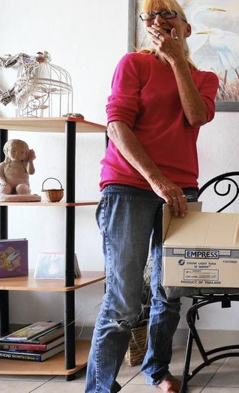
Aa
Typography
Cardo: A timeless and graceful serif font that brings sophistication to large text in print and online. Use sparingly.
Tenor Sans: Primary serif for most headings and larger digital body text
Arimo: Primary serif for smaller or longer body text and professional documents; accessible for Spanish language translations
Homeless Services Network
2025

Slide 5
Cardo
ABCEFGHIJKLMO
QRSTUVWXZY
123456789
Display font for headers and branding.
  Why It Works:
    Style: Old-style serif
    Vibe: Elegant, timeless, literary
    Use Case: Good for print materials, less ideal for small digital text
    Accessibility: Can be slightly hard to read at small sizes
    Use sparingly – beautiful but not ideal for smaller text
Homeless Services Network
Type: Serif
-
Style: Old Style
-
2025
www.hsncfl.org

Slide 6
Tenor Sans
ABCEFGHIJKLMO
QRSTUVWXZY
123456789
Primary serif for sub-headings and some digital body text
Why It Works:
  Style: Clean, accessible sans-serif with modern proportions
  Vibe: Warm, highly readable, and trustworthy
  Use Case: Known for its even spacing and rounded letterforms, making it highly legible for both both body text and headlines
  Accessibility: Ideal for print and web.
  Recommended – balances classic elegance with modern accessibility; includes extended Latin and Cyrillic alphabets, supporting various languages
Homeless Services Network
Type: Serif
-
Style: Traditional
-
2025
www.hsncfl.org

Slide 7
Arimo
ABCEFGHIJKLMO
QRSTUVWXZY
123456789
Primary serif for longer body text and professional documents
Why It Works:
  Style: Classic serif
  Vibe: Timeless, clean, highly readable
  Use Case: Ideal for longer body text, emails, reports, and presentations
  Accessibility: Excellent legibility on screens and in print, even at small sizes
  Recommended – well-balanced serif that is easy on the eyes, even in longer text blocks; complements Cardo and Arimo
Homeless Services Network
Type: Serif
-
-
Style: Clean
2025
www.hsncfl.org

Slide 8
Calibri
ABCEFGHIJKLMO
QRSTUVWXZY
123456789
Primary sans serif for digital and professional documents
Why It Works:
  Vibe: Clean, approachable, and versatile
  Use Case: Perfect for emails, reports, slide decks, and general body text where clarity is key
  Accessibility: Designed specifically for on‑screen readability; maintains excellent legibility at small sizes and across devices
  Recommended – a balanced, professional sans serif that feels more approachable than Arial or Times New Roman; pairs well with serif options like Georgia or Cardo for headings
Homeless Services Network
Type: Sans serif
-
Style: Modern
-
2025
www.hsncfl.org

Slide 9

Logo
Figure with Raised Arms:
Evokes hope, support, and upliftment.
The arms forming a roof symbolize shelter and protection — images that are core to the mission.
Heart Above the Roof:
Reinforces the message of care, compassion, and humanity.
Typography:
Clean, sans-serif fonts suggest clarity, modernity, and accessibility.
Hierarchical layout (HSN > Network > Region) guides the viewer’s eye effectively.
The logo communicates a mission-driven, compassionate, and trustworthy organization.
It balances emotional warmth (heart, teal) with professionalism (black, structured layout).
The design is inclusive and accessible, aligning well with the values of a social service network.
Homeless Services Network
2025
www.hsncfl.org

Slide 10
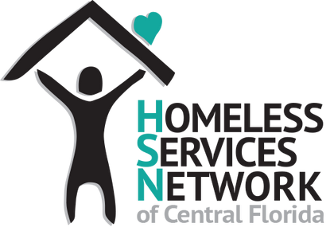


Logo File Types
Homeless Services Network
.PNG (Transparent background, websites, social)
-
-
.EPS/.AI (Preferred by designers, large printing)
.JPG / .JPEG (Compressed, for documents)
-
-
.PDF (Both print and digital, embed vector data)
2025
www.hsncfl.org

Slide 11
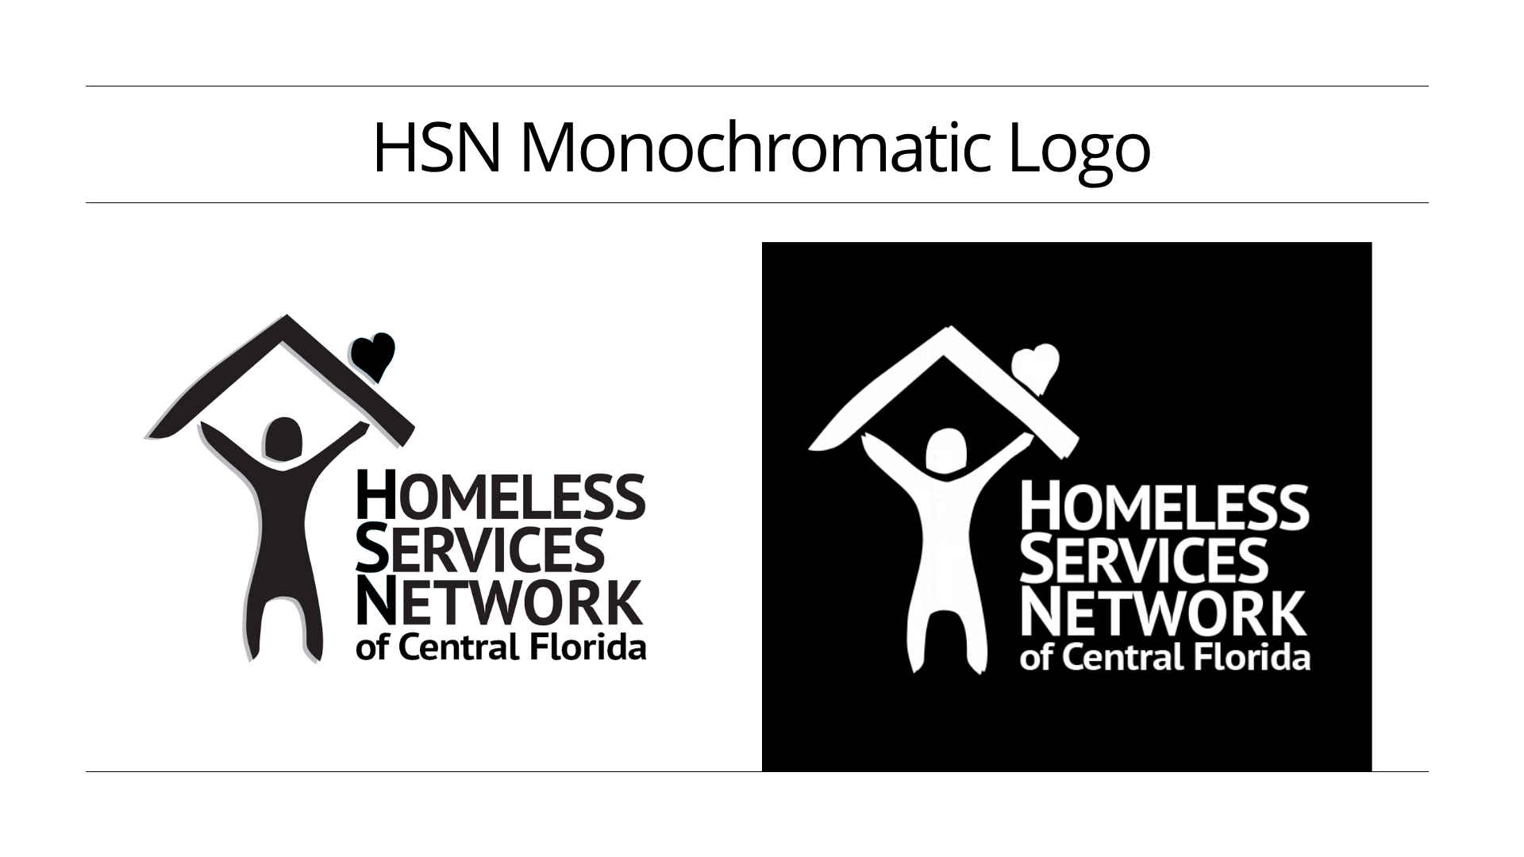

Slide 12
Base Colors
Why This Works:
  Teal and blue are your brand anchors.
  Mustard adds warmth and contrast.
  Navy provides depth and professionalism.
  Vivid orchid introduces a vibrant, friendly tone.
  All colors maintain strong text contrast for accessibility.
Homeless Services Network
#08bcb0
#2fa4f3
#FFB545
#003F5C
#d90368
2025
www.hsncfl.org

Slide 13
Base Colors
When to Use Each Main Brand Color:
Teal - CMYK: (88, 10, 43, 2)
  Use as your primary brand color for headers, buttons, icons, and backgrounds. Ideal for conveying trust, calm, and compassion.
Blue - CMYK: (70, 42, 0, 11)
  Can be used alongside the primary teal for depth or variation in branding.
Mustard - CMYK: (0, 29, 73, 0)
  Use for calls to action, highlights, or warm accents. Great for drawing attention and adding energy.
Navy - CMYK: (100, 33, 0, 64)
  Use for backgrounds, headers, or formal documents. Conveys stability, intelligence, and trustworthiness.
Orchid - CMYK: (0, 63, 79, 10)
  Use for emphasis, alerts, or emotional storytelling. Adds warmth and urgency to key messages.
#08bcb0
#2fa4f3
#FFB545
#003F5C
Homeless Services Network
#d90368
2025
www.hsncfl.org

Slide 14
Ext. Colors
Color Palette
This complements our original 5-color set beautifully, giving us a 10-color extended palette that is both accessible and visually rich. Use sparingly, extended colors should never overpower your core palette. Maintain harmony, ensure they complement your main colors in tone and saturation.
Homeless Services Network
#5941eb
#ee3826
#7D3C98
#A97142
#30b045
2025
www.hsncfl.org

Slide 15
Ext. Colors
#5941eb
#ee3826
When to Use Extended Colors
1. Functional Purposes
  UI/UX elements: For alerts (e.g., red for errors, green for success), tooltips, or hover states.
  Infographics & charts: Helps differentiate data points without overwhelming the core brand.
  Forms & buttons: Use for secondary actions or status indicators.
2. Campaigns & Events
  Seasonal campaigns or special events may call for a temporary color variation.
  Extended colors allow flexibility without breaking brand consistency.
3. Audience Segmentation
  Different departments, services, or audiences can be color-coded using extended colors.
4. Print & Collateral Design
  Brochures, posters, and reports often need more visual variety than digital interfaces.
  Extended colors can add depth and hierarchy.
5. Accessibility & Contrast
  Some extended colors may offer better contrast for specific backgrounds or accessibility needs (e.g., colorblind-friendly palettes).
#7D3C98
#A97142
Homeless Services Network
#30b045
2025
www.hsncfl.org

Slide 16
Text Colors
The effectiveness of text color on a background comes down to contrast and readability. High contrast between text and background ensures that the content is legible and accessible to all users, including those with visual impairments. Here are a few recommednations:
White
White
Black
White
White
Homeless Services Network
White
White
White
White
White
2025
www.hsncfl.org

Slide 17

Brand
Identity
Homeless Services Network
“Everyone on my team feels a sense of victory whenever someone is able to escape homelessness and move into stable housing. That’s what keeps us all going – knowing that we can make that difference.”
2025
– Martha Are, CEO, Homeless Services Network of Central Florida

Slide 18

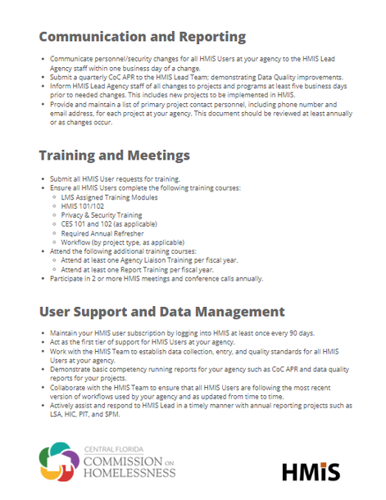
Brand consistency is crucial because it builds recognition, trust, and professionalism.
Here's why it matters so much:
  Builds Brand Recognition
    When your logo, colors, fonts, and tone are used consistently, people begin to recognize your brand instantly—whether it's on a website, flyer, or social media post.
  Establishes Trust and Credibility
    Consistency signals reliability. If your brand looks and sounds the same across all touchpoints, it feels more professional and trustworthy to your audience.
  Reinforces Your Identity
    Your brand is more than a logo—it's a personality. Consistent use of visuals and messaging reinforces who you are and what you stand for.
  Improves Marketing Effectiveness
    When your brand elements are aligned, your campaigns are more cohesive and impactful. It also makes it easier to scale your marketing across platforms and teams.
  Supports a Unified Voice
    Whether you're speaking to donors, clients, or the public, a consistent tone and style ensure your message is clear and aligned with your mission.
Homeless Services Network
2025

Slide 19

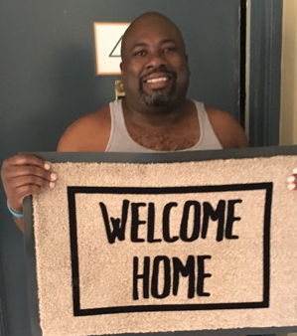
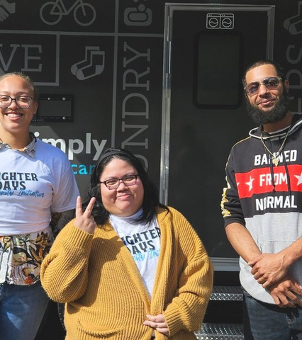

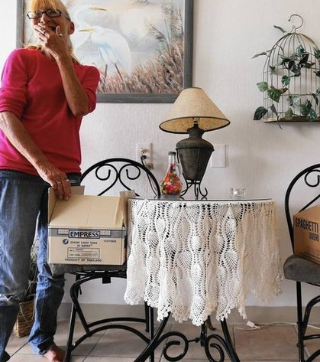

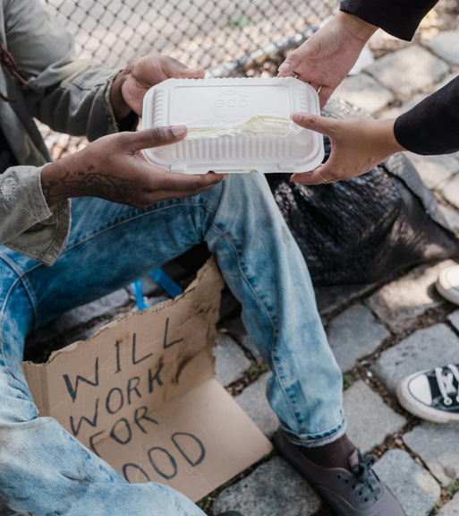
Homeless Services Network
2025

Slide 20
Brand Assets Usage Statement
All logos, images, graphics, and written content contained within this brand guide and associated materials are the intellectual property of Homeless Services Network and are protected by applicable copyright, trademark, and intellectual property laws.
Permitted Use
Authorized individuals and partners may use these brand assets for official communications, marketing, and promotional purposes that align with the mission and values of Homeless Services Network, provided they:
  Do not alter, distort, or modify the logo or brand elements in any way.
  Maintain proper color, spacing, and proportion as outlined in this guide.
  Use approved file formats and versions of the logo and assets.
Homeless Services Network
Prohibited Use
Brand assets may not be used:
  For personal or commercial gain unrelated to the organization.
  In any way that misrepresents or misaligns with the organization’s values.
  In political, religious, or controversial contexts without prior written approval.
2025
www.hsncfl.org

Slide 21
Brand Guideline
  About Brand
  Brand Concept
  Brand Details
Thank You
Email Address
Homeless Services Network
info@hsncfl.org
Phone
(407) 893-0133
Mailing Address
142 E Jackson Street,
Orlando, FL 32801
2025
www.hsncfl.org

