Slide 1
HMIS Advisory
Committee Meeting
Central Florida Commission on Homelessness (CFCH)
CoC FL-507
May 13th, 2025
Melissa Sandel, Committee Chair
Notes:
Call to order: Brad -All in attendance verify name, add agency
Next slide: Brad (agenda)

Slide 2
HMIS Advisory Committee Mission
HMIS Advisory Committee Purpose
Our mission is to effectively use data, which includes inputs from those in need of services, those providing services, and from members of the community, to eliminate homelessness in Central Florida.
Oversee the CoC’s implementation of HMIS, what we do with the data and how we use it.
Notes:
Presenter: Brad
Next Slide: Brad

Slide 3
HMIS Advisory Committee
Chair | Melissa Sandel | Christian Service Center
Vice Chair | Brad Sefter | Healthcare Center for the Homeless
Secretary/Recorder | Danielle Landaal | IDignity
Voting Member | Keisha Thomas | The Sharing Center
Voting Member | Caren Olsen | Covenant House
Voting Member | Karen Jackson | Zebra Youth Coalition
Voting Member | Nancy Martinez | Samaritan Resource Center
HMIS Team Liaison | Brittney Behr | HSN - HMIS Data Analyst
Notes:
Presenter: Brad -Committee Roll Call
Next Slide: Brad (Agenda Roll Call)

Slide 4
Agenda
Welcome
Call to Order
Committee Roll Call
Voice Vote – Approval of minutes for March 11th, 2025
Voice Vote - Agenda for May 13th, 2025
HMIS Team Reports:
System Performance Measures Submission Review
ROI and Client Access Rights Videos – Final Versions
Community Dashboard Planning
Review breakout room notes from last meeting
Showcase HSN Enrollment Summary Dashboard
Dashboard Planning Next Steps
COMMITTEE VOTE - All motions before committee
Notes:
Presenter: Brad -Agenda Roll Call Vote (meeting minutes from last meeting uploaded here: https://www.hmiscfl.org/hmis-advisory-committee-2/)
Next: Rocky

Slide 5
HMIS Team Reports
System Performance Measures Submission Review
ROI and Client Access Rights Videos – Final Versions
Community Dashboard Planning
Notes:
Presenter: Brad
Next Slide: Ashley

Slide 6
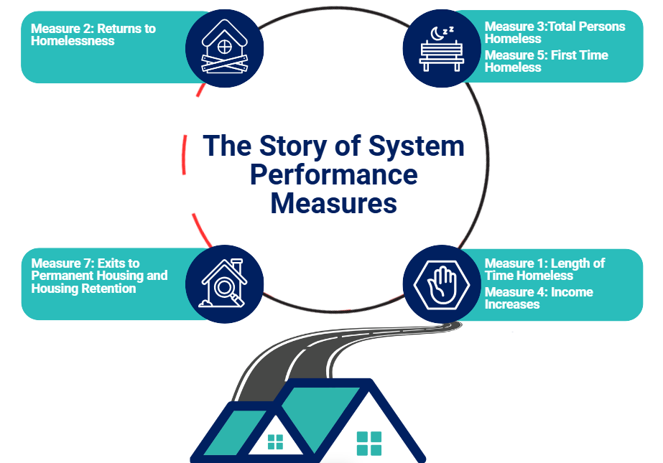
System Performance Measures Submission Review
We submitted the SPM data to HUD on 4/9/2025
"System Performance Measures" are a series of metrics that measure system level performance of our homeless response system.
Find official reports and dashboard are updated on our website.
Let's Review the 23-24 System Performance Measures Infographic

Slide 7
Reporting Timeline Update
The Point-in-Time (PIT) & Housing Inventory Count (HIC) report submissions to HUD announced:
Portal opens May 13th, data is due June 13th
Gender data will not be submitted
Infographics available on the HMIS website are UNOFFICIAL: PIT Infographics Available Here

Slide 8
Release of Information Video Review – Final Versions
Client Access Rights Training
Release of Information Training

Slide 9
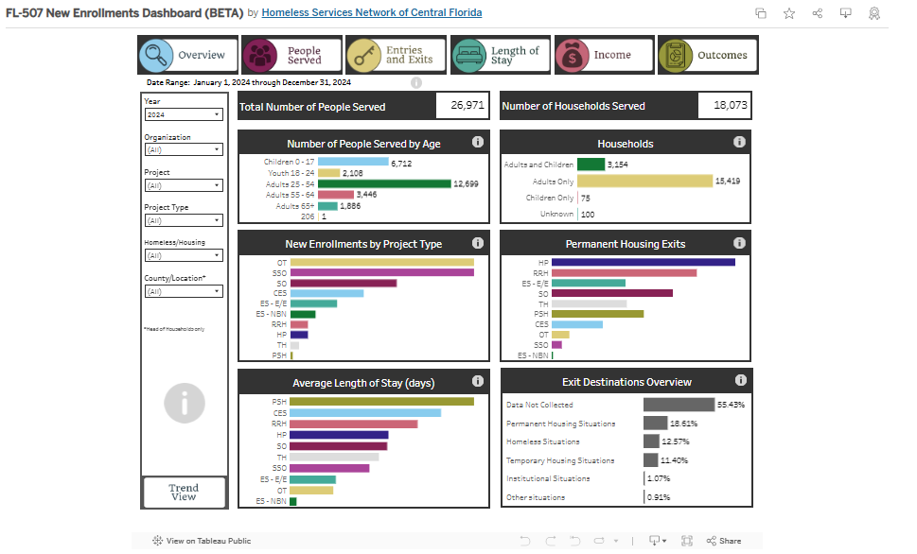
Community Dashboard Planning
Feedback from last session:
Group 1: Requested additional data points – customizable age ranges, education status, case notes
Group 2: Wants to have fiscal year be an available date range. Desire to have client ID's included in the dashboard. Can dashboards/EVA replace reports already being used?
Group 3: Looking for a tool that can easily show enrollment data and data quality issues, specifically around exits.
Group 4: An important point for group 4 was Street Outreach entries and exits. They wish reports were easier to run and contained everything in one.
Notes:
HUD with its HMIS Standards and the HMIS complaint vendors have taken every possible step to ensure the privacy and security of the data that we collect on the people who we serve in our homeless response system. Close to 500 individual users from approximately 60 agencies in the Central Florida region, have committed themselves to implementing these standards using the community vetted software tools recommended by our HMIS Advisory Committee and supported by HSN’s HMIS staff. Eva is here to help us better understand our story, the story of how we have been able to respond to the housing crisis being lived everyday by so many of our neighbors with the limited resources at our hands.

Slide 10
Community Dashboard Planning
Main Themes:
1. Customization & Flexibility in Data Views
Customizable age ranges
Education status filters
Fiscal year as a selectable date range
Client ID inclusion
2. Usability & Integration
Interest in whether dashboards/EVA can replace current reports
Preference for simpler, more consolidated reporting tools
3. Data Quality & Specific Use Cases
Need to highlight data quality issues, especially around client exits
Emphasis on Street Outreach data (entries/exits)
Desire for clear, accessible enrollment data
Notes:
HUD with its HMIS Standards and the HMIS complaint vendors have taken every possible step to ensure the privacy and security of the data that we collect on the people who we serve in our homeless response system. Close to 500 individual users from approximately 60 agencies in the Central Florida region, have committed themselves to implementing these standards using the community vetted software tools recommended by our HMIS Advisory Committee and supported by HSN’s HMIS staff. Eva is here to help us better understand our story, the story of how we have been able to respond to the housing crisis being lived everyday by so many of our neighbors with the limited resources at our hands.

Slide 11
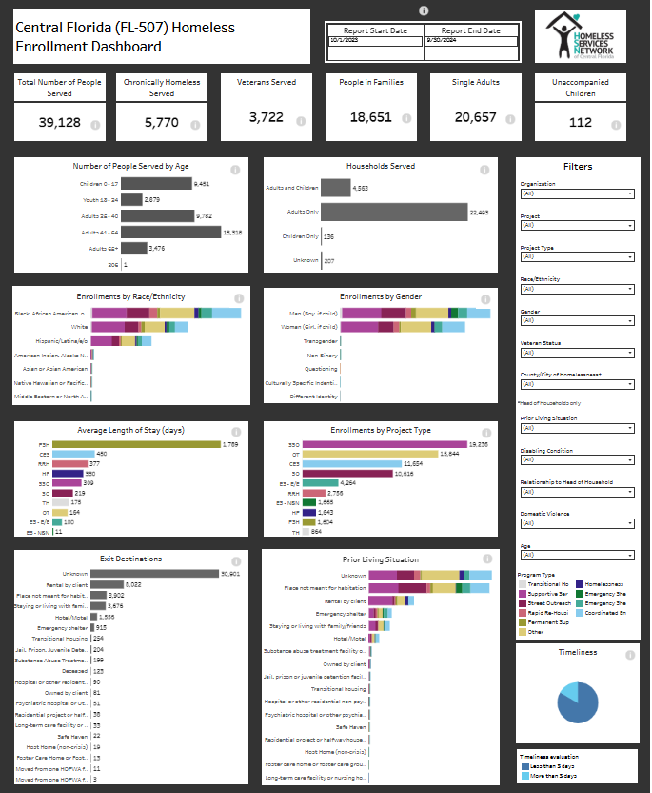
Community Dashboard Planning
Differences
 | New Enrollments Dashboard | HSN Enrollment Summary Dashboard
Date ranges | Fixed to last 4 calendar years | Adjustable to any dates (defaulted to last fiscal year)
Enrollment scope | Only includes enrollments created in the calendar year | Includes all active enrollments per date range
Filters | Allows filtering by homeless vs housed projects | Allows filtering by: veteran status, race/ethnicity, gender, age, prior living situation, disabling condition, domestic violence & relationship to head of household
Update Timeframe | Once a year refresh | Monthly refresh
Notes:
HUD with its HMIS Standards and the HMIS complaint vendors have taken every possible step to ensure the privacy and security of the data that we collect on the people who we serve in our homeless response system. Close to 500 individual users from approximately 60 agencies in the Central Florida region, have committed themselves to implementing these standards using the community vetted software tools recommended by our HMIS Advisory Committee and supported by HSN’s HMIS staff. Eva is here to help us better understand our story, the story of how we have been able to respond to the housing crisis being lived everyday by so many of our neighbors with the limited resources at our hands.

Slide 12
Community Dashboard Planning
Let's look at a different dashboard base that addresses some of the themes: customizable date ranges, customizable ages, simpler enrollment data, and potential to build specific views based on community feedback:
Notes:
HUD with its HMIS Standards and the HMIS complaint vendors have taken every possible step to ensure the privacy and security of the data that we collect on the people who we serve in our homeless response system. Close to 500 individual users from approximately 60 agencies in the Central Florida region, have committed themselves to implementing these standards using the community vetted software tools recommended by our HMIS Advisory Committee and supported by HSN’s HMIS staff. Eva is here to help us better understand our story, the story of how we have been able to respond to the housing crisis being lived everyday by so many of our neighbors with the limited resources at our hands.

Slide 13
Dashboard Planning: Next Steps
Creation of a dashboard sub-committee that meets more regularly
If you are interested in being a part of this sub-committee, please let us know in chat or send a ticket to: hmis@hsncfl.org
Goal: develop a dashboard that we can begin training the entire community to use (focus on performance data)
Sub-goal: develop a view for each project type
Creation of data quality dashboard (in progress)
Goal: Bring EVA analytics to the community in a way that supports data quality
Sub-goal: include client ID data for fast and easy error resolution (no additional reports needed to resolve errors)

Slide 14
HMIS Training & Support
Our routine monthly training calendar:
1st & 3rd Tuesday: HMIS 101 New User Training (9a - 2p)
2nd & 4th Wednesday: HMIS 101/102 Refreshers (2p - 4p)
3rd Tuesday: ClientTrack Introduction to Reports Training (3p - 4:30p)
Ad-Hoc Reports Training (request via HMIS Support Ticket)
APR/CAPER in ClientTrack
Everyday Reporting in ClientTrack
Explore Data Explorer
Data Quality Workshop
Join us for our office hours M/W from 1p - 2p for additional one-on-one HMIS support.
Reminders:
All new user training requests must come through the Agency Liaison.
Agency Liaison needs to let the HMIS team know ASAP when someone leaves
the agency so we can inactivate accounts. This is to protect the system and keep an accurate count of available subscriptions for assignment.
Notes:
Presenter: Racquel
Next Slide: Racquel
Next Slide: Raquel

Slide 15
HMIS Training & Support
HMIS data collection templates are available on our website at: www.hmiscfl.org
Recommended to have hard copies on hand in the event that inclement weather results in a power outage.
Fillable templates available for all projects types and collection points
entry, exit, update and annual assessment templates
emergency shelter, transitional, rapid-rehousing, PATH, SSVF, ect.
Schedule a Live HMIS Refresher Training!
Agencies are invited to schedule an in-person HMIS Refresher training for your HMIS users. This opportunity is now available year-round!
Schedule your agency for this training by submitting a training request via the support ticket system.
Questions? Contact us at hmis@hsncfl.org
Notes:
Presenter: Racquel
Next Slide: Racquel

Slide 16
HSN University Training
We are encouraging our trainees to complete the HMIS 101 New User Training
via HSN University vs waiting for a live training session.
HMIS 101 Course Requirements include:
Completion of all required course modules;
Demonstrate knowledge in the practical portion of the training by completing required tasks/workflows in the HMIS training site;
Review, sign and submit the HMIS User Agreement
Other courses available in HSN University include:
HMIS 101 New User HMIS Agency Liaison Orientation
HMIS 101: Refresher HMIS 102: PATH
HMIS 102: Street Outreach HMIS 102: SSVF
Upcoming Virtual Courses: Reporting and Data Quality in ClientTrack
Notes:
Presenter: Racquel
Next Slide: Racquel

Slide 17
HMIS Data Quality Monitoring
Our current fiscal year is coming to a close!
Providers are expected to review and clean up data as much as possible for:
October 1, 2023 to September 30, 2024
Data Quality Clean-Up Tips
Run the Clients in Program Report and Annual Performance Report within the first weeks of October.
Review and correct data where possible in APR Data Quality Tables.
Q5a
Q6a - Q6f
Review accuracy of active enrollments.
Close out clients no longer receiving services.
Be sure to add all necessary services prior to exiting clients out of projects.
Reminder: Data cleansing helps prepare our community for reporting to HUD and other federal funders and give us an accurate picture of what is going on in our community/system.
Notes:
Presenter: Racquel
Next Slide: Brad
Next Slide: Ashley
Next Slide: Ashley

Slide 18
Committee Roll-Call Vote
HMIS Committee Officers
Notes:
Presenter: Brad
Next Slide: Brad

Slide 19
Committee Roll-Call Vote
Any other motion before committee
Notes:
Presenter: Brad -Open to motions by committee members
Next Slide: Brad

Slide 20
Thank you for attending!
Next meeting date:
Tuesday, July 8th, 2025
10:30 am to 12:00 pm
HMIS Guides, Documents, Training, Acronyms & More
hmiscfl.org
https://www.hmiscfl.org/training/datadefinitions/
Notes:
Brad Closes Meeting

Slide 21
HSN HMIS Team
Angel Jones
Director of Information Systems
Racquel McGlashen
HMIS System Administrator
Agustin “Tino” Paz
HMIS Senior Data Analyst
Brittney Behr
HMIS Data Analyst I
Tim Reed
HMIS Partner Success Specialist
Gregory Carter
HMIS Partner Success Specialist
Moesha Herron
HMIS Partner Success Specialist
Oscar Lin
HMIS Website Development Intern

