Slide 1
HMIS Advisory
Committee Meeting
Central Florida Commission on Homelessness (CFCH)
CoC FL-507
Jan 9th, 2024
Brad Sefter, Committee Chair
Notes:
Call to order: Brad -All in attendance verify name, add agency
Next slide: Brad (agenda)

Slide 2
HMIS Advisory Committee Mission
HMIS Advisory Committee Purpose
Our mission is to effectively use data, which includes inputs from those in need of services, those providing services, and from members of the community, to eliminate homelessness in Central Florida.
Oversee the CoC’s implementation of HMIS, what we do with the data and how we use it.
Notes:
Presenter: Brad
Next Slide: Brad

Slide 3
HMIS Advisory Committee
Chair | Brad Sefter | Health Care Center for the Homeless
Vice Chair | Danielle Landaal | IDignity
Secretary/Recorder
Voting Member | Tracy Dale | Catholic Charities
Voting Member | Corey Berg | Family Promise of Greater Orlando
Voting Member | Keisha Thomas | The Sharing Center
Voting Member | Deborah Del Moral | The Sharing Center
Voting Member
HMIS Team Liaison | Brittney Behr | HSN - HMIS Project Coordinator
Notes:
Presenter: Brad -Committee Roll Call
Next Slide: Brad (Agenda Roll Call)

Slide 4
Agenda
Call to Order
Committee Roll Call
Approval - Minutes from Nov 14th, 2023
Voice Vote - Agenda for Jan 9th, 2023
HMIS Team Reports:
  PIT Count: Changes to Data Collection - Brittney Behr
  Onsite Refreshers Announcement - Racquel McGlashen
  HMIS Dashboard Demo - Ashley Brozenske
  Referrals Update - Angel Jones
  Reporting Season Updates: LSA and SPMs - Brittney Behr
COMMITTEE VOTE - All motions before committee
Notes:
Presenter: Brad -Agenda Roll Call Vote (meeting minutes from last meeting uploaded here: https://www.hmiscfl.org/hmis-advisory-committee-2/)
Next: Brad

Slide 5
Officer Reports
  PIT Count: Changes to Data Collection - Brittney Behr
  Onsite Refreshers Announcement - Racquel McGlashen
  HMIS Dashboard Demo - Ashley Brozenske
  Referrals Update - Angel Jones
  Reporting Season Updates: LSA and SPMs - Brittney Behr
Notes:
Presenter: Brad
Next Slide: Brittney

Slide 6
PIT Count - Volunteers needed!
The PIT count will take place on: Jan 23rd-25th
Multiple shifts available: 9am-Noon, Noon-3pm, 3-6pm, 6-9pm
Shifts available in Orange, Osceola and Seminole Counties
Click the links above to sign up!
Notes:
Presenter: Brittney
Next Slide: Brittney

Slide 7
PIT Count
Per updates to the FY2024 HMIS Data Standards, HUD combined the race and ethnicity options into a single element that now allows for the response options below.
1) American Indian, Alaska Native, or Indigenous
2) Asian or Asian American
3) Black, African American, or African
4) Hispanic/Latina/e/o
5) Middle Eastern or North African
6) Native Hawaiian or Pacific Islander
7) White
Notes:
Presenter: Ashley
Next Slide: Ashley

Slide 8
PIT Count
CoCs should continue to allow people experiencing homelessness to select as many options that apply to them as they want. When reporting to HUD CoCs will report based on the following categories.
1) American Indian, Alaska Native, or Indigenous
2) American Indian, Alaska Native, or Indigenous & Hispanic/Latina/e/o
3) Asian or Asian American
4) Asian or Asian American & Hispanic/Latina/e/o
5) Black, African American, or African
6) Black, African American, or African & Hispanic/Latina/e/o
7) Hispanic/Latina/e/o
8) Middle Eastern or North African
9) Middle Eastern or North African & Hispanic/Latina/e/o
10) Native Hawaiian or Pacific Islander
11) Native Hawaiian or Pacific Islander & Hispanic/Latina/e/o
12) White
13) White & Hispanic/Latina/e/o
14) Multi-Racial & Hispanic/Latina/e/o
15) Multi-Racial (not Hispanic/Latina/e/o)
Notes:
Presenter: Ashley
Next Slide: Ashley

Slide 9
PIT Count
Changes to the Gender data element will work similarly.People experiencing homelessness will have the ability to select multiple gender response options. If more than one gender is selected, CoC’s will report the data in the following categories:
1) Includes Woman (Girl if child)
2) Includes Man (Boy if child)
3) Includes Culturally Specific Identity (e.g., Two-Spirit)
4) Includes Transgender
5) Includes Non-Binary
6) Includes Questioning
7) Includes Different Identity
Notes:
Presenter: Ashley
Next Slide: Ashley

Slide 10
HSN University Training
Just as a reminder - when training requests are submitted to our team for New User training, the trainee is automatically assigned to the virtual course. This allows for your staff members to get through the training and into the live system more quickly vs waiting for the next available live training session (via Zoom).
HMIS 101 Course Requirements include:
  Completion of all required course modules;
  Demonstration knowledge in the practical portion of the training by completing required tasks/workflows in the HMIS training site;
  Review, sign and submit the HMIS User Agreement
Other courses available in HSN University at this time include:
HMIS 101: Refresher
HMIS 102: SSVF
HUD FY24 Data Standard Updates: https://hsnuniversity.litmos.com?C=11685072
Upcoming Virtual Courses: HMIS 102: Street Outreach & PATH
Notes:
Presenter: Racquel
Next Slide: Racquel

Slide 11

HMIS Training & Support
Our routine monthly training calendar:
1st & 3rd Tuesday: HMIS 101 New User Training (9a - 2p)
2nd & 4th Wednesday: HMIS 101/102 Refreshers (2p - 4p)
3rd Tuesday: ClientTrack Introduction to Reports Training (3p - 4:30p)
Ad-Hoc Reports Training (request via HMIS Support Ticket)
APR/CAPER in ClientTrack
Everyday Reporting in ClientTrack
Explore Data Explorer
Data Quality Workshop
Join us for our office hours M/W from 1p - 2p for additional one-on-one HMIS support.
Reminders:
All new user training requests must come through the Agency Liaison.
Agency Liaison needs to let the HMIS team know ASAP when someone leaves
the agency so we can inactivate accounts. This is to protect the system and keep an accurate count of available subscriptions for assignment.
Notes:
Presenter: Racquel
Next Slide: Racquel
Next Slide: Raquel

Slide 12
HMIS Training & Support
HMIS data collection templates are available on our website at: www.hmiscfl.org
Recommended to have hard copies on hand in the event that inclement weather results in a power outage.
Templates available for all projects types and collection points
  entry, exit, update and annual assessment templates
  emergency shelter, transitional, rapid-rehousing, PATH, SSVF, ect.
Fillable version of the data collection templates will be available on our website by the end of this week, November 17th, 2023.
Schedule a Live HMIS Refresher Training!
Starting this month, agencies are invited to schedule an in-person HMIS Refresher training for your HMIS users. Submit a ticket to request the training and receive available dates for the next 3 months.
Questions? Contact us at hmis@hsncfl.org
Notes:
Presenter: Racquel
Next Slide: Racquel

Slide 13
HMIS Data Quality Monitoring
End of Fiscal Year HMIS Check-in
We are ready to schedule DQMs for the first quarter of this fiscal year (Oct - Dec 2023). Scorecards will be sent out to all agencies around the end of this month. Between mid-Jan to the end of March, providers are expected to review and clean up data for both FY2022-2023, as well as this first quarter.
The Agenda
For agency liaisons attending, you can expect the following items to be covered in this session:
Review of active users at your agency
Project review: any missing start/end dates, funding source(s), funding start/end dates
Project review: data quality for FY 22-23 (Oct. 1, 2022 to Sept. 30, 2023) AND Oct - Dec 2023
A link to schedule will be sent out in the next couple weeks for agency liaisons to set a date/time for your DQMs in February.
We look forward to meeting with you!
Notes:
Presenter: Racquel
Next Slide: Brittney
Next Slide: Ashley
Next Slide: Ashley

Slide 14
HMIS Dashboard Demo
HMIS and Data Visualization
Let’s take a look…
Sr. Data Analyst: agustin.paz@hsncfl.org
Data Analyst: ashley.brozenske@hsncfl.org
Notes:
Presenter: Angel
Next Slide: Angel
Next Slide: Ashley
Next Slide: Ashley

Slide 15
Referral Updates
Referral Form Location
  hmiscfl.org/referral-setup/
Purpose: Referrals help streamline the complex process of addressing homelessness, improve the effectiveness of services, and contribute to the overall goal of reducing and preventing homelessness in communities.
Recommended Changes
  Let’s take a look at the changes to the
  referral setup form!
Notes:
Presenter: Angel
Next Slide: Angel

Slide 16
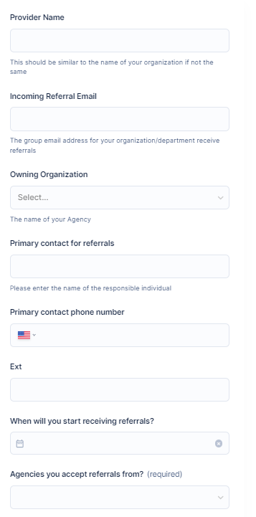
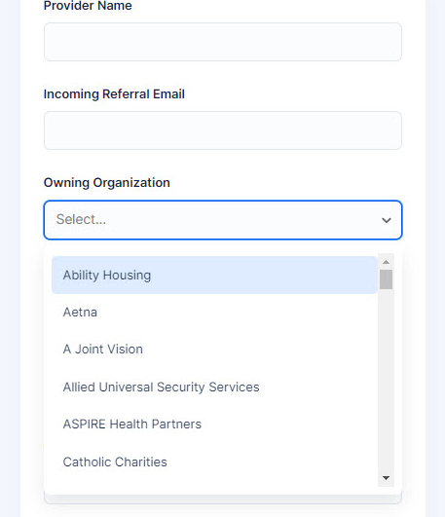
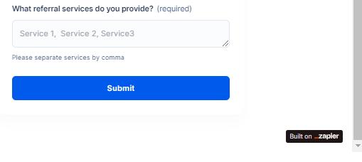
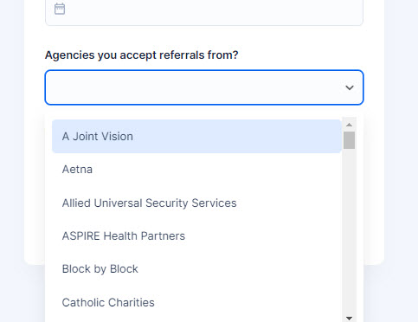
Referrals Update - Set Up Form
DROPDOWN
DROPDOWN
Notes:
Presenter: Angel
Next Slide: Angel

Slide 17
Referrals Next Steps
Discuss next steps for referral implementation
HMIS Team Needs
  Set Providers in ClientTrack
  Create Referral training materials
  Create MOU with CoC Lead
  Begin Beta Testing Period
  Release Full Referral System in HMIS
  TBD
Provider Needs
  Set up a central email address (e.g. referral@youragency.org)
  Complete the new Referral Setup form (available here)
  HMIS will reach out to collect the optional MOU with agencies, if indicated by the setup form
  Beta Testers Volunteers
Feedback on referral implementation
Notes:
Presenter: Angel
Next Slide: Brittney

Slide 18
Reporting Season Updates
1/17/2024
Longitudinal Systems Analysis (LSA)
LSA Data Points:
Relationship to HoH
Date of Birth
Move-in Date
Close Inactive Projects
The LSA includes a 3-year lookback of system-level data that can be filtered by demographics and system pathways. It gives a high-level understanding of a system’s response to homelessness. Stella-P uses LSA data to generate charts. View last year’s submission here on our website)
TBD - Feb 2024
System Performance Measures (SPMs)
SPM Data Points:
Annual Assessments
Move-in Date
Exit Destination
SPMs are a series of 6 metrics used to evaluate effectiveness of a homeless response system. SPMs include: length of time homeless, first-time homeless, total homeless, exits to permanent housing, returns to homelessness, and income growth. View last year’s submission here on our website
TBD - April 2024
Point-in-Time Count (PIT)
PIT Data Points:
Relationship to HoH
Date of Birth
Race, Gender, Vet Status
Enrollments
The PIT count is an annual survey of people experiencing homelessness in our service area on a single night (the actual count can be performed over multiple days). PIT data includes people in emergency shelters and transitional housing, as well as people engaged on the streets or in another unsheltered location. View last year’s submission here on our website
TBD - April 2024
Housing Inventory Chart (HIC)
HIC Data Points:
Total Beds
Total Units
Household Types
The HIC is a count of inventory for projects that provide housing or lodging, including ES, TH, RRH, PSH and OPH projects. This is used along with the PIT to determine utilization of a homeless response systems dedicated resources. This data is updated once a year prior to submitting. View last year’s submission here on our website
Notes:
Presenter: Brittney
Next Slide: Brittney

Slide 19
Reporting Season Updates
What Your Organization Can Do To Support The Reporting Season:
Review your Data Quality Scorecards and participate in Data Quality Monitors
Correct missing/inaccurate data in ClientTrack
  Enter missing Move-in dates
  Collect missing demographic data, such as; race, gender, or age
  Enter missed Annual Assessments (required every 365 days from Project Start)
  Ensure current enrollments accurately reflect clients being served
Respond to requests for data
  Requests to review and update Bed Inventory (February-March)
  Requests to correct incomplete or inaccurate data
  Requests to explain data discrepancies (December-January)
Volunteer for the PIT Count
  The unsheltered PIT count takes place from Jan 23rd-Jan 25th.
  To stay informed about the Count, please complete the contact form here.
Thank you in advance for all of your help and support!
Notes:
Presenter: Brittney
Next Slide: Brittney

Slide 20
Reporting Season Updates
The LSA data is reported through a dashboard tool called Stella-P…
Let’s take a look!
Notes:
Presenter: Brittney
Next Slide: Brad

Slide 21
Committee Roll-Call Vote
HMIS Committee Officers
Notes:
Presenter: Brad
Next Slide: Brad

Slide 22
Committee Roll-Call Vote
Any other motion before committee
Notes:
Presenter: Brad -Open to motions by committee members
Next Slide: Brad

Slide 23
Thank you for Attending!
Next meeting date:
Tuesday, March 12th, 2024
10:30 am to 12:00 pm
HMIS Guides, Documents, Training, Acronyms & More
hmiscfl.org
https://www.hmiscfl.org/training/datadefinitions/
Notes:
Brad Closes Meeting

Slide 24
HSN HMIS Team
Angel Jones
HMIS Operations Manager
Agustin “Tino” Paz
HMIS Senior Data Analyst
Ashley Brozenske
HMIS Data Analyst I
Brittney Behr
HMIS Project Coordinator
Racquel McGlashen
HMIS Partner Success Specialist
Tyler Claitt
HMIS System Success Specialist

