Slide 1
HMIS Advisory
Committee Meeting
Central Florida Commission on Homelessness (CFCH)
CoC FL-507
Nov 14th, 2023
Brad Sefter, Committee Chair
Notes:
Call to order: Brad -All in attendance verify name, add agency
Next slide: Brad (agenda)

Slide 2
HMIS Advisory Committee Mission
HMIS Advisory Committee Purpose
Our mission is to effectively use data, which includes inputs from those in need of services, those providing services, and from members of the community, to eliminate homelessness in Central Florida.
Oversee the CoC’s implementation of HMIS, what we do with the data and how we use it.
Notes:
Presenter: Brad
Next Slide: Brad

Slide 3
HMIS Advisory Committee
Chair | Brad Sefter | Health Care Center for the Homeless
Vice Chair | Danielle Landaal | IDignity
Secretary/Recorder
Voting Member | Tracy Dale | Catholic Charities
Voting Member | Corey Berg | Family Promise of Greater Orlando
Voting Member | Keisha Thomas | The Sharing Center
Voting Member | Deborah Del Moral | The Sharing Center
Voting Member
HMIS Team Liaison | Brittney Behr | HSN - HMIS Project Coordinator
Notes:
Presenter: Brad -Committee Roll Call
Next Slide: Brad (Agenda Roll Call)

Slide 4
Agenda
Call to Order
Committee Roll Call
Approval - Minutes from Sept 12th, 2023
Voice Vote - Agenda for Nov 14th, 2023
HMIS Team Reports:
  Memorial Day Service Announcement - Danielle Landaal
  Pathways of Youth Research Project Update - Dr. Andrew Sullivan
  YHDP Updates - Aja Hunter
  HMIS Entry Assessment Update - Ashley Brozenske
  Referrals Update: Set Up Form - Angel Jones
  Upcoming DQM’s - Racquel McGlashen
  Reporting Season Updates - Brittney Behr
COMMITTEE VOTE - All motions before committee
Notes:
Presenter: Brad -Agenda Roll Call Vote (meeting minutes from last meeting uploaded here: https://www.hmiscfl.org/hmis-advisory-committee-2/)
Next: Brad

Slide 5
Officer Reports
  Memorial Day Service Announcement - Danielle Landaal
  Pathways of Youth Research Project Update - Dr. Andrew Sullivan
  YHDP Updates - Aja Hunter
  HMIS Entry Assessment Update - Ashley Brozenske
  Referrals Update: Set Up Form - Angel Jones
  Upcoming DQM’s - Racquel McGlashen
  Reporting Season Updates - Brittney Behr
Notes:
Presenter: Brad
Next Slide: Danielle

Slide 6

Memorial Day Service Announcement
If you have names of any clients who have passed away, please email them to reservations@idignity.org
Notes:
Presenter: Danielle
Next Slide: Dr. Andrew Sullivan

Slide 7
Navigating Pathways out of Homelessness for Youth: An Analysis of Shelter Utilization in Central Florida
Seongho An School of Public Administration University of Central Florida | Shuang Lu School of Social Work University of Central Florida | Andrew Sullivan School of Public Administration University of Central Florida
Notes:
Presenter: Dr. Sullivan

Slide 8
Research Overview
What are the service pathways of youth (aged 18-24) through the homeless service system?
Which pathway, youth shelter or general shelter, relates to a shorter experience of homelessness?
Methods
  Exact matching and survival analysis
Using a youth shelter with general services related with a shorter duration of homelessness
Notes:
Presenter: Dr. Sullivan

Slide 9
Youth Homelessness
Many homeless youth had adverse childhood experiences
  Homelessness can exacerbate these negative experiences
  A lengthy episode of homelessness could lead to long-term disadvantages accumulating, such as not pursuing higher education, lower earnings, and poor mental health
Navigating services can be complicated, increasing duration of homelessness or leading to ineffective services
  Understanding where to find the most appropriate services and achieve housing
  Using a youth service provider could offer tailored services, easing these information challenges
Notes:
Presenter: Dr. Sullivan

Slide 10
Data
Homeless Management Information System (HMIS) data
  2002-May 2023
  All shelter, transitional housing, permanent supportive housing, rapid rehousing, support services, and coordinated entry enrollments
Limit sample to the 15,179 youth
  Look at youth-episode observations
  Consider multiple enrollments one episode if <7 between enrollments
Notes:
Presenter: Dr. Sullivan

Slide 11
Methods
Network Analysis
  Shows the multiple pathways youth took depending on exit type
  Exits
    Permanent supportive housing, independent housing, transitional housing, institution, other shelter, unsheltered
Survival analysis
  How long until achieve housing, contingent on no return?
  Treatment: using youth shelter compared with others
  Exact match youth based on demographics (race, gender, disability, veteran, age at entry) and control for entry month and year
  Limit to youth not returning for this analysis
Notes:
Presenter: Dr. Sullivan

Slide 12
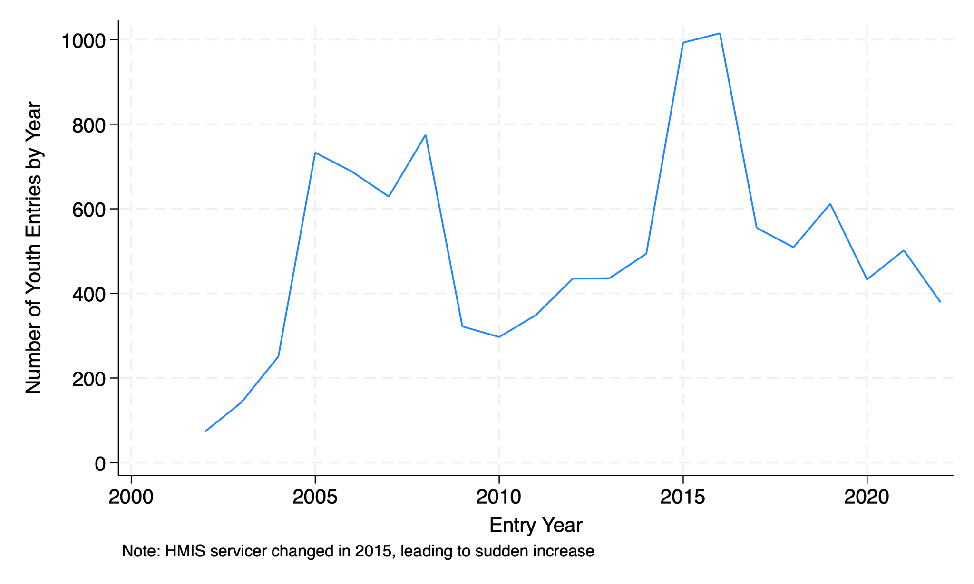
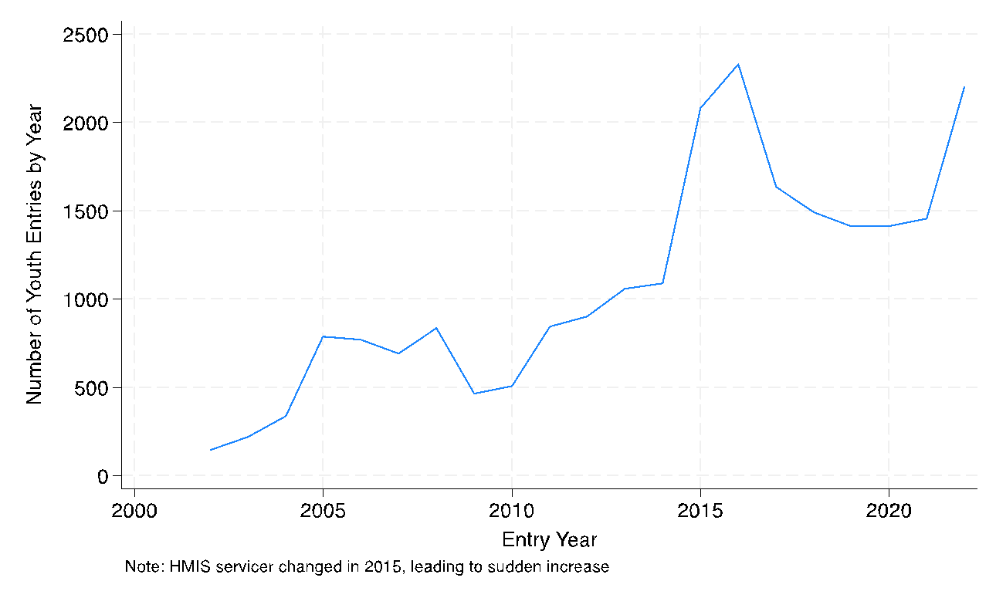
The number of youth emergency shelter entries has declined
Notes:
Presenter: Dr. Sullivan

Slide 13
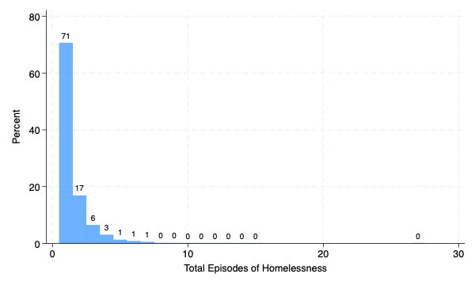
Most (71%) youth only had one episode
Notes:
Presenter: Dr. Sullivan

Slide 14
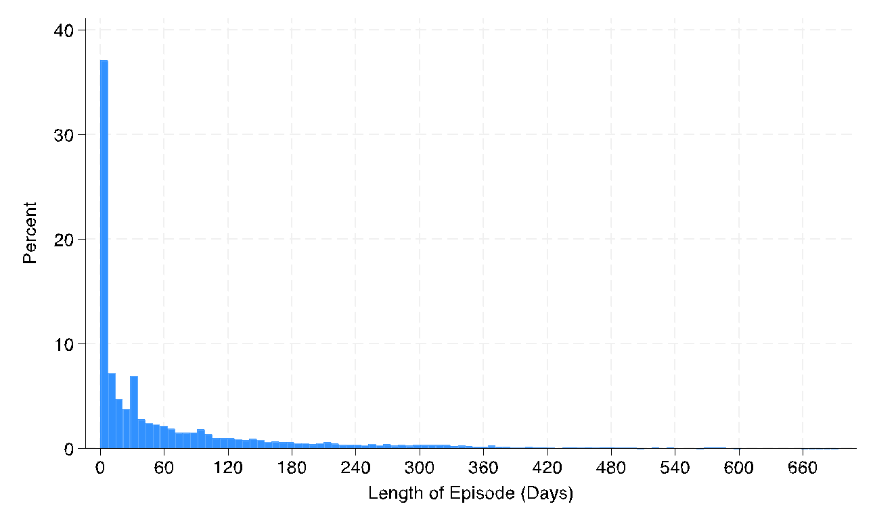
Half spent less than 24 days in services
Notes:
Presenter: Dr. Sullivan

Slide 15
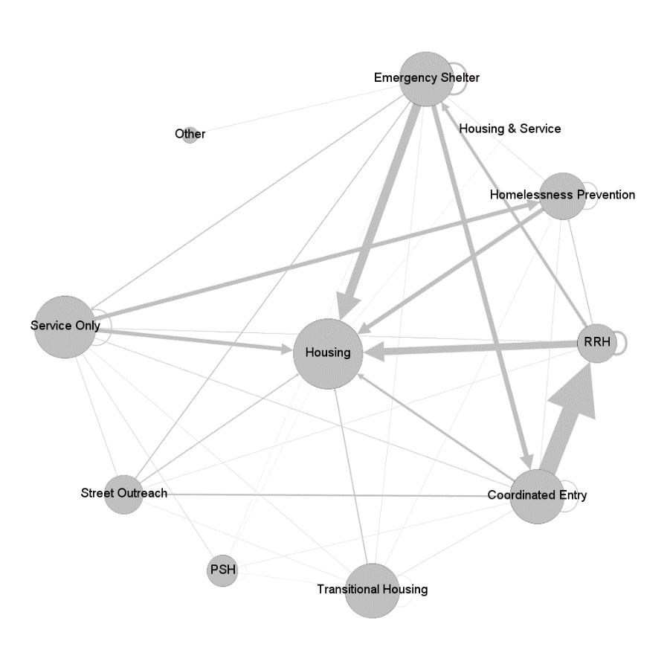
Emergency shelter is the most commonly last-used service type and central to network
Notes:
Presenter: Dr. Sullivan

Slide 16
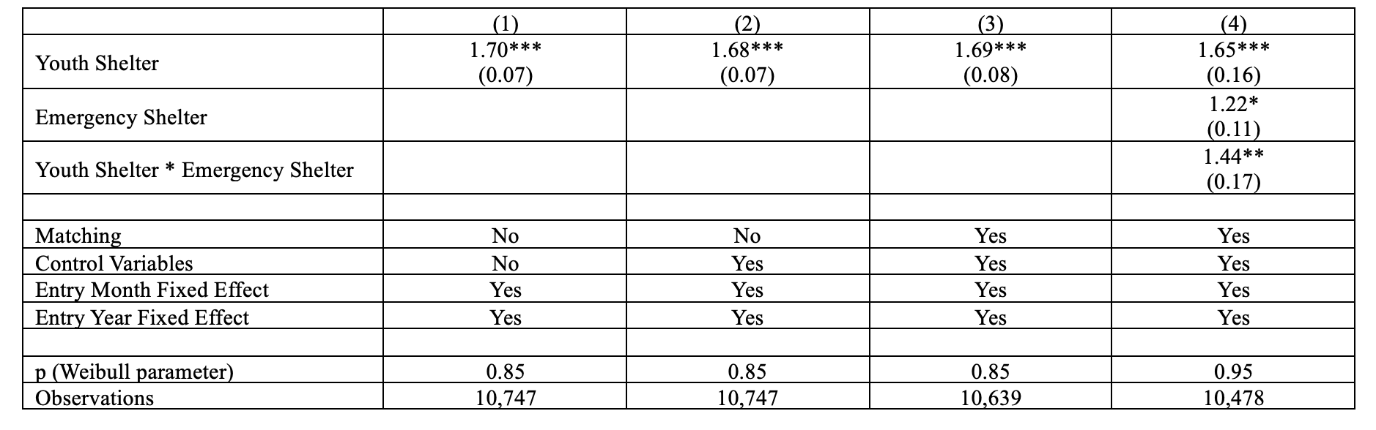
Using youth shelter relates with shorter duration
Notes:
Presenter: Dr. Sullivan

Slide 17
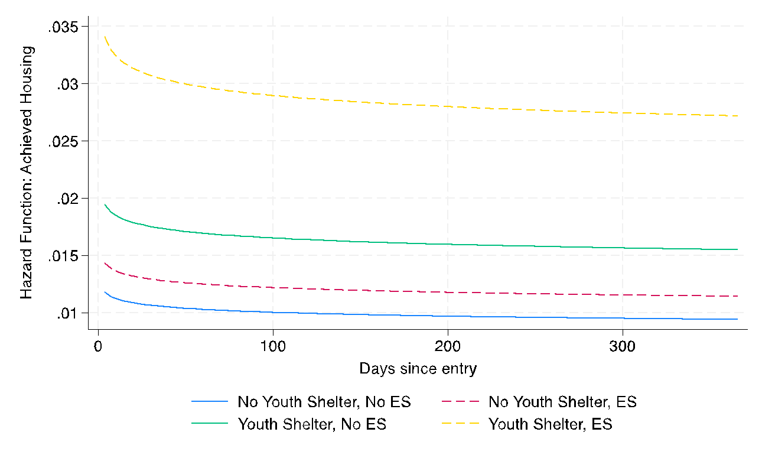
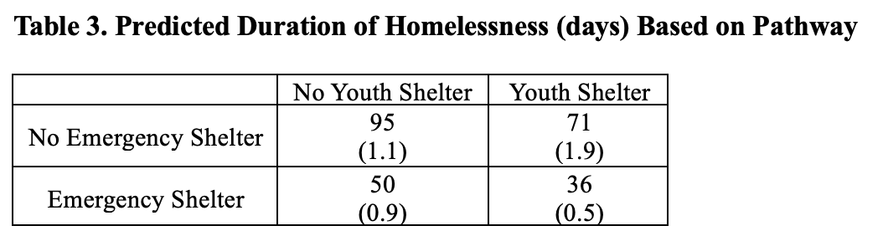
Hazard Function
Notes:
Presenter: Dr. Sullivan

Slide 18
Takeaway and next steps
Using a youth shelter with emergency shelter related with a short duration of homelessness
Next steps
  Exploring information pathways to see pathway to youth shelter
  Factoring into the analysis returns to homelessness
Notes:
Presenter: Dr. Sullivan

Slide 19
Q&A
Thank you!
Andrew.sullivan@ucf.edu
Notes:
Presenter: Dr. Sullivan
Next Slide: Aja Hunter

Slide 20
HMIS Entry Assessment Update
In early October 3792 enrollments in our HMIS were identified with the error of missing entry assessments.
It is imperative that these errors are resolved because they create issues when troubleshooting and submitting annual reports.
An email was sent October 9th asking agencies to fix these errors with instructions on how to do so.
Currently there are 2568 enrollments with this error (32% error resolution).
Soon Eccovia (our software vendor) will run a script to fix these errors by creating entry assessments for the remaining enrollments missing entry assessments.
Once the script is run, the error of missing entry assessments will be resolved, but data quality errors will persist (assessment will be populated with blanks for all responses except CoC - Client Location).
Notes:
Presenter: Ashley
Next Slide: Ashley

Slide 21
HMIS Entry Assessment Update
TAKEAWAYS
Once the script is run, the system will have NO MISSING ENTRY ASSESSMENT. Please help to keep the system healthy by refraining from creating these errors in the future!
Complete all workflows - do not cancel in the middle of the workflow.
  If you do not have all the information you need to complete the workflow, use “data not collected” in the responses. You can always go back and change the responses later when you collect the information.
Review your paused workflows to determine if you have incomplete enrollments.
If an enrollment was made in error notify your agency liaison or HMIS immediately so that the enrollment can be deleted.
Notes:
Presenter: Ashley
Next Slide: Angel

Slide 22
Referrals Update - Set Up Form
When?
  TBD
Where?
  hmiscfl.org/referral-setup/
Why?
  Facilitate the seamless & organized sharing of participant needs
    Streamlined Service Coordination
    Client-Centered Care
    Data Collection and Reporting
    Coordinated Case Management
    Efficiency and Resource Allocation
How?
  Let’s take a look at the form together!
Referrals help streamline the complex process of addressing homelessness, improve the effectiveness of services, and contribute to the overall goal of reducing and preventing homelessness in communities.
Notes:
Presenter: Angel
Next Slide: Angel

Slide 23
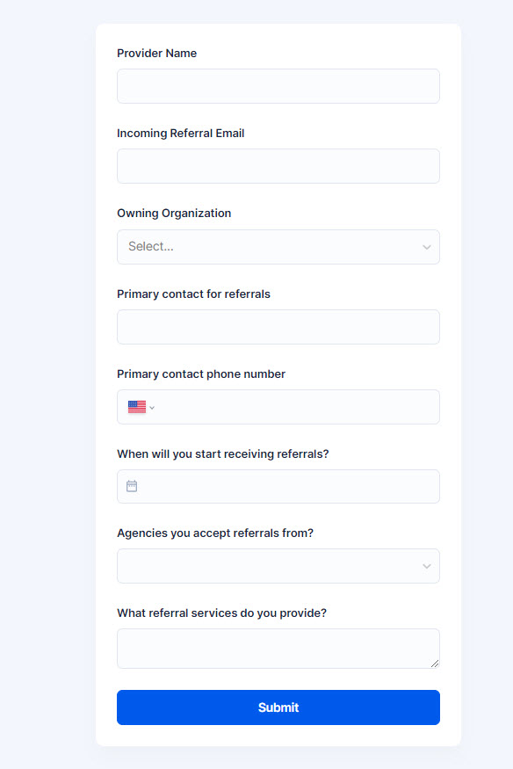
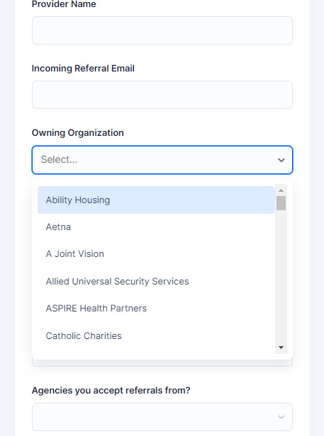
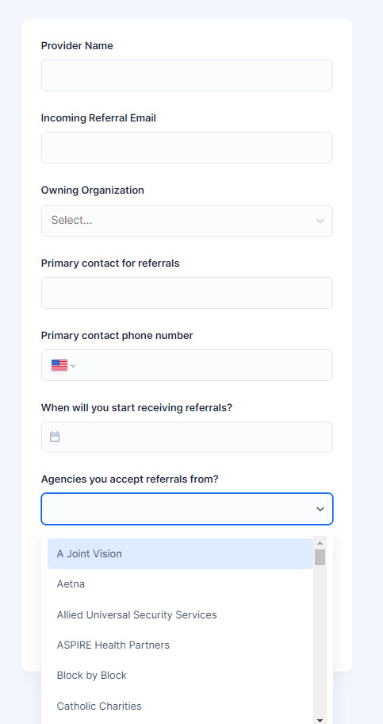
Referrals Update - Set Up Form
DROPDOWN
DROPDOWN
Notes:
Presenter: Angel
Next Slide: Angel

Slide 24
Referrals Next Steps
Discuss next steps for referral implementation
HMIS Team
  Referrals training materials
  Set up Referrals in ClientTrack
  Create MOU with CoC Lead
  Provide Beta Testing Period
  Release Full Referral System in HMIS
Providers
  Set up a central email address (e.g. referral@youragency.org)
  Complete the new Setup form (available here)
  HMIS will reach out to collect the optional MOU with agencies, if indicated by the setup form
  Beta Testers Needed
Feedback on referral implementation
Notes:
Presenter: Brittney/Chuck
Next Slide: Wyatt

Slide 25
HSN University Training
Just as a reminder - when training requests are submitted to our team for New User training, the trainee is automatically assigned to the virtual course. This allows for your staff members to get through the training and into the live system more quickly vs waiting for the next available live training session (via Zoom).
HMIS 101 Course Requirements include:
  Completion of all required course modules;
  Demonstration knowledge in the practical portion of the training by completing required tasks/workflows in the HMIS training site;
  Review, sign and submit the HMIS User Agreement
Other courses available in HSN University at this time include:
HMIS 101: Refresher
HMIS 102: SSVF
HUD FY24 Data Standard Updates: https://hsnuniversity.litmos.com?C=11685072
Upcoming Virtual Courses: HMIS 102: Street Outreach & PATH
Notes:
Presenter: Racquel
Next Slide: Racquel

Slide 26

HMIS Training & Support
Our routine monthly training calendar:
1st & 3rd Tuesday: HMIS 101 New User Training (9a - 2p)
2nd & 4th Wednesday: HMIS 101/102 Refreshers (2p - 4p)
3rd Tuesday: ClientTrack Introduction to Reports Training (3p - 4:30p)
Ad-Hoc Reports Training (request via HMIS Support Ticket)
APR/CAPER in ClientTrack
Everyday Reporting in ClientTrack
Explore Data Explorer
Data Quality Workshop
Join us for our office hours M/W from 1p - 2p for additional one-on-one HMIS support.
Reminders:
All new user training requests must come through the Agency Liaison.
Agency Liaison needs to let the HMIS team know ASAP when someone leaves
the agency so we can inactivate accounts. This is to protect the system and keep an accurate count of available subscriptions for assignment.
Notes:
Presenter: Racquel
Next Slide: Racquel
Next Slide: Raquel

Slide 27
HMIS Training & Support
HMIS data collection templates are available on our website at: www.hmiscfl.org
Recommended to have hard copies on hand in the event that inclement weather results in a power outage.
Templates available for all projects types and collection points
  entry, exit, update and annual assessment templates
  emergency shelter, transitional, rapid-rehousing, PATH, SSVF, ect.
Fillable version of the data collection templates will be available on our website by the end of this week, November 17th, 2023.
Questions? Contact us at hmis@hsncfl.org
Notes:
Presenter: Racquel
Next Slide: Racquel

Slide 28
HMIS Data Quality Monitoring
End of Fiscal Year HMIS Check-in
We are in the midst of meeting with partnering agencies to review users and projects in the system. Scorecards will be sent out to all agencies by mid-December, providing ample time for data clean up for FY22-23 in preparation for report submissions occurring around April/May of 2024.
The Agenda
For agency liaisons attending, you can expect the following items to be covered in this session:
Review of active users at your agency
Project review: start/end dates, funding source(s), funding start/end dates
Project review: bed count for applicable projects (ES, TH, PH, PSH, RRH)
Project review: data quality for FY 22-23 (Oct. 1, 2022 to Sept. 30, 2023)
If you have not yet scheduled to meet with us, please do so at your easiest convenience using this scheduling link: https://calendly.com/hmis/dataqualitymonitor
Come prepared with knowledge of your existing projects, bed inventory if applicable, and related funding source information!
Notes:
Presenter: Racquel
Next Slide: Brittney
Next Slide: Ashley
Next Slide: Ashley

Slide 29
Reporting Season Updates
1/17/2024
Longitudinal Systems Analysis (LSA)
LSA Data Points:
Relationship to HoH
Date of Birth
Move-in Date
Close Inactive Projects
The LSA includes a 3-year lookback of system-level data that can be filtered by demographics and system pathways. It gives a high-level understanding of a system’s response to homelessness. Stella-P uses LSA data to generate charts. View last year’s submission here on our website)
TBD - Feb 2024
System Performance Measures (SPMs)
SPM Data Points:
Annual Assessments
Move-in Date
Exit Destination
SPMs are a series of 6 metrics used to evaluate effectiveness of a homeless response system. SPMs include: length of time homeless, first-time homeless, total homeless, exits to permanent housing, returns to homelessness, and income growth. View last year’s submission here on our website
TBD - April 2024
Point-in-Time Count (PIT)
PIT Data Points:
Relationship to HoH
Date of Birth
Race, Gender, Vet Status
Enrollments
The PIT count is an annual survey of people experiencing homelessness in our service area on a single night (the actual count can be performed over multiple days). PIT data includes people in emergency shelters and transitional housing, as well as people engaged on the streets or in another unsheltered location. View last year’s submission here on our website
TBD - April 2024
Housing Inventory Chart (HIC)
HIC Data Points:
Total Beds
Total Units
Household Types
The HIC is a count of inventory for projects that provide housing or lodging, including ES, TH, RRH, PSH and OPH projects. This is used along with the PIT to determine utilization of a homeless response systems dedicated resources. This data is updated once a year prior to submitting. View last year’s submission here on our website
Notes:
Presenter: Brittney
Next Slide: Brittney

Slide 30
Reporting Season Updates
What Your Organization Can Do To Support The Reporting Season:
Review your Data Quality Scorecards and participate in Data Quality Monitors
Correct missing/inaccurate data in ClientTrack
  Enter missing Move-in dates
  Collect missing demographic data, such as; race, gender, or age
  Enter missed Annual Assessments (required every 365 days from Project Start)
  Ensure current enrollments accurately reflect clients being served
Respond to requests for data
  Requests to review and update Bed Inventory (February-March)
  Requests to correct incomplete or inaccurate data
  Requests to explain data discrepancies (December-January)
Volunteer for the PIT Count
  The unsheltered PIT count takes place from Jan 23rd-Jan 25th.
  To stay informed about the Count, please complete the contact form here.
Thank you in advance for all of your help and support!
Notes:
Presenter: Brittney
Next Slide: Brad

Slide 31
Committee Roll-Call Vote
HMIS Committee Officers
Notes:
Presenter: Brad
Next Slide: Brad

Slide 32
Committee Roll-Call Vote
Any other motion before committee
Notes:
Presenter: Brad -Open to motions by committee members
Next Slide: Brad

Slide 33
Thank you for Attending!
Next meeting date:
Tuesday, Jan 9th, 2024
10:30 am to 12:00 pm
HMIS Guides, Documents, Training, Acronyms & More
hmiscfl.org
https://www.hmiscfl.org/training/datadefinitions/
Notes:
Brad Closes Meeting

Slide 34
HSN HMIS Team
Angel Jones
HMIS Operations Manager
Agustin “Tino” Paz
HMIS Senior Data Analyst
Ashley Brozenske
HMIS Data Analyst I
Brittney Behr
HMIS Project Coordinator
Chuck Vroman
HMIS System Success Specialist
Racquel McGlashen
HMIS Partner Success Specialist
Tyler Claitt
HMIS System Success Specialist

