Slide 1
HMIS Advisory
Committee Meeting
Central Florida Commission on Homelessness (CFCH)
CoC FL-507
May 9, 2023
Wyatt Haro, Committee Chair
Notes:
Call to order: Wyatt -All in attendance verify name, add agency
Next slide: Wyatt (agenda)

Slide 2
HMIS Advisory Committee Mission
HMIS Advisory Committee Purpose
Our mission is to effectively use data, which includes inputs from those in need of services, those providing services, and from members of the community, to eliminate homelessness in Central Florida.
Oversee the CoC’s implementation of HMIS, what we do with the data and how we use it.
Notes:
Presenter: Wyatt
Next Slide: Wyatt

Slide 3
HMIS Advisory Committee
Chair | Wyatt Haro | Miracle of Love
Vice Chair
Secretary/Recorder
Voting Member | Brad Sefter | Health Care Center for the Homeless
Voting Member | Latoya Sheffield | Wayne Densch
Voting Member | Danielle Landaal | IDignity
Voting Member
Voting Member
HMIS Team Liaison | Brittney Behr | HSN - HMIS Project Coordinator
Notes:
Presenter: Wyatt -Committee Roll Call -July Minutes Roll Call Vote (Meeting Minutes - HMIS Advisory Committee 2022-07-12 (hmiscfl.org))
Next Slide: Wyatt (Agenda Roll Call)

Slide 4
Agenda
Call to Order
Committee Roll Call
Roll Call Vote - Minutes from March 14th, 2023
Roll Call Vote - Agenda for May 9th, 2023
HMIS Team Reports:
  YHDP Updates - Special Guest Aja Hunter
  Pathways of Youth - Special Guest Dr. Andrew Sullivan
  PIT/HIC Submission
  County of Homelessness - Proposal
  Data Standards Update
  Referrals Discussion
  Advisory Committee Structure - Upcoming Elections
  Breakout Rooms Discussion - Topic recommendations, concerns, questions about ClientTrack menu options, etc.
COMMITTEE VOTE - All motions before committee
Notes:
Presenter: Wyatt -Agenda Roll Call Vote
Next: Wyatt

Slide 5
Officer Reports
YHDP Updates - Special Guest Aja Hunter
Pathways of Youth - Special Guest Dr. Andrew Sullivan
PIT/HIC Submission - Brittney Behr
County of Homelessness Proposal - Angel Jones
Data Standards Update - Brittney Behr
Referrals Discussion - Brittney Behr
Advisory Committee Structure and Elections - Wyatt Haro
Notes:
Presenter: Wyatt
Next Slide: Aja

Slide 6

YHDP Updates
Link to Central Florida CCP
Notes:
Presenter: Aja
Next: Aja

Slide 7
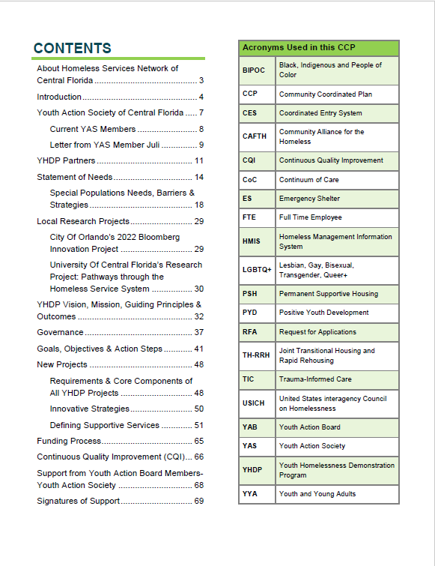
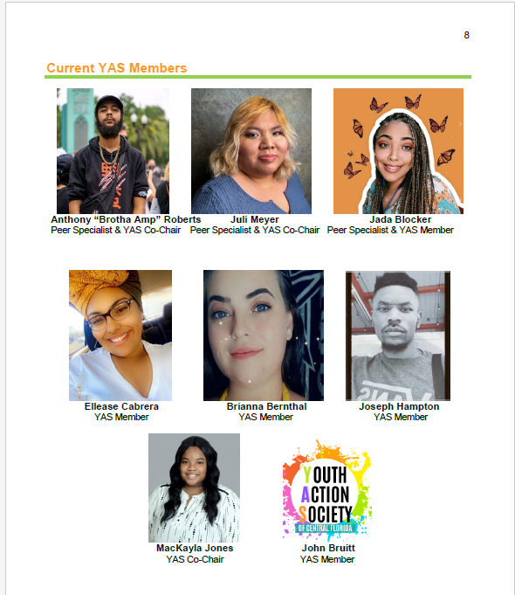
YHDP- CCP Updates
Notes:
Presenter: Aja
Next: Aja

Slide 8








What Does it Mean to be a YHDP Community- Moving from Potluck Services to…
Notes:
Aja

Slide 9













What Does it Mean to be a YHDP Community- Collaboration and Shared Resources to…..
Notes:
Aja

Slide 10









What Does it Mean to be a YHDP Community- Coordinated Community Approach (meal)
Notes:
Aja

Slide 11
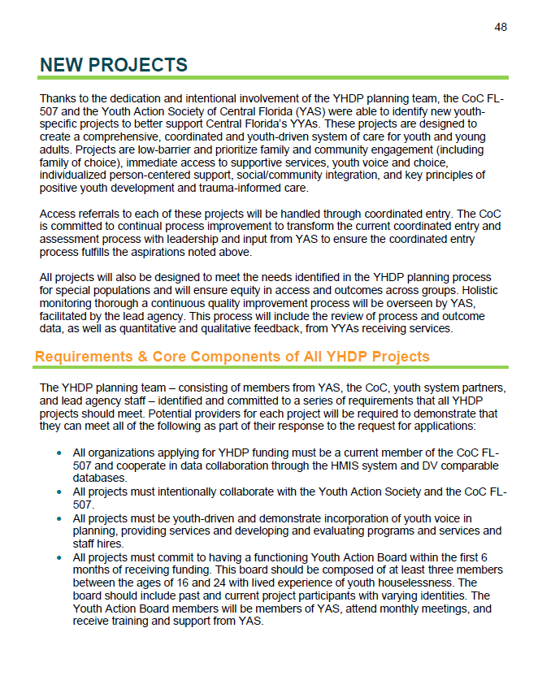

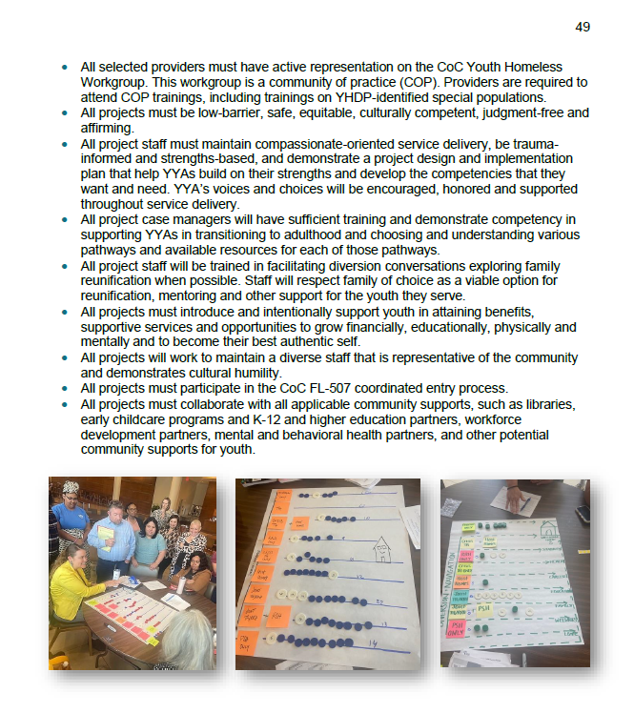
Notes:
Aja

Slide 12
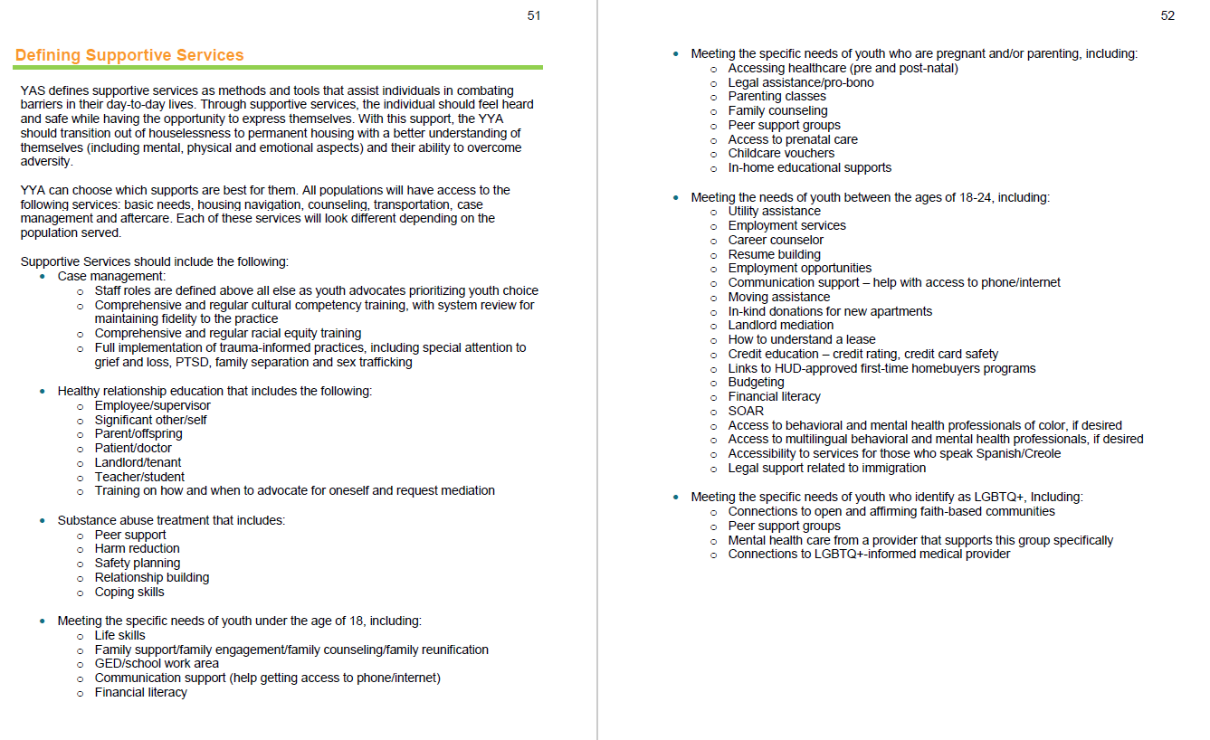
Notes:
Aja

Slide 13
YHDP Funded Projects
Youth Focused HMIS- 1 FTE - $82,500
Youth Specific CE Supports- 2 FTE - $230,389
Youth Centralized Diversion- $154,880
SSO- Youth Navigation- 10 FTE - $929,500
SSO- Drop-In Center/ Outreach- 4 FTE - $ 302,500
SSO- Host Home (Innovative Housing Strategies)- 3 FTE - $451,000
Youth Joint TH-RRH- 8 FTE - $1,575,200
Youth PSH- 1 FTE - $407,000
Notes:
Aja

Slide 14
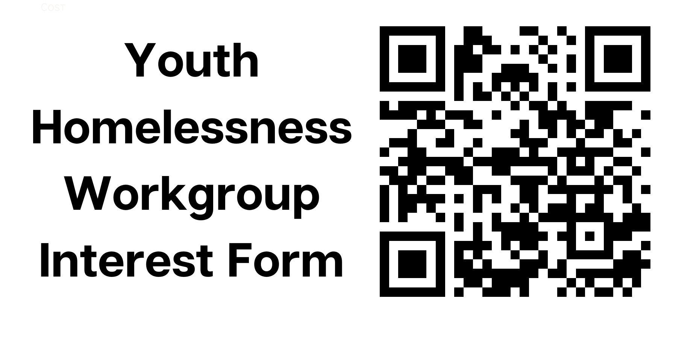

YHDP- Call to Action
Upcoming YHDP Community Meeting- RFA Discussion
May 11th- 9am - 10:30am
or
May 12th- 12pm- 1:30pm
Registration Link
Complete the survey here.
Complete the survey here.
Notes:
Presenter: Aja
Next Slide: Dr. Andrew Sullivan

Slide 15

Pathways of Youth through the Homeless Service System
Notes:
Presenter: Dr Sullivan

Slide 16
Research Team
Seongho An
  School of Public Administration
  Homelessness, E-advocacy of nonprofit organizations and digital technology in nonprofit management
Bella Lu
  School of Social Work
  Child and youth development in disadvantaged families, community-based psycho-social interventions, and nonprofit capacity building
Andrew Sullivan
  School of Public Administration
  Homeless services and public and nonprofit finance
Notes:
Presenter: Dr Sullivan

Slide 17
Cumulative Disadvantages of Homelessness
Homelessness is caused by and exacerbates additional disadvantages
  E.g., poverty, lack of affordable housing, discrimination
Youth homelessness can create cumulative disadvantages, creating a cycle of barriers
Notes:
Presenter: Dr Sullivan

Slide 18
Navigating Pathways out of Homelessness for Youth
How do youth move through the homeless service system?
Which pathways have the shortest duration of homelessness (with no return to homelessness)?
Notes:
Presenter: Dr Sullivan

Slide 19

Service Pathways
Which path has the shortest duration?
Notes:
Presenter: Dr Sullivan

Slide 20
Analysis
Using HMIS and supplemental data
Comparing service providers
  Not comparing specific service providers, but types
  E.g., location, size, target population
Comparing youth
  Match similar youth entering the same shelter, but taking different service paths
Notes:
Presenter: Dr Sullivan

Slide 21
Future Research: Photovoice
Provide youth experiencing homelessness cameras to photograph their experiences
  Followed by interviews
Gives youth control of their narrative and story
  Fills in how service pathways affect their experiences
  Helps support organizations working to end youth homelessness
Notes:
Presenter: Dr Sullivan

Slide 22
Partnership
UCF Downtown faculty are working to build partnerships with the local community
  Work with our community to achieve our goals
  UCF Carnegie Classification for Community Engagement
Opportunities
  Guest speak in nonprofit management/local government classes
  Center for Public and Nonprofit Management Capacity Building Seminar and Partners Conference
  Capstone projects and internships
  Doctoral student dissertations
  Ad-hoc projects
Notes:
Presenter: Dr Sullivan

Slide 23
Questions and Feedback
Seongho.an@ucf.edu
Shuanglu@ucf.edu
Andrew.Sullivan@ucf.edu
Notes:
Presenter: Dr Sullivan
Next Slide: Brittney

Slide 24

HMIS Reporting Season 2023
The submission of the PIT and HIC marks the end of the HMIS HUD Reporting Season.
Thank you for all your help and support during the last few months!
If you are interested in seeing the full results, you can review the data here: https://www.hmiscfl.org/reports/
1/13/2023
Longitudinal Systems Analysis (LSA)
The LSA includes a 3-year lookback of system-level data that can be filtered by demographics and system pathways. It gives a high-level understanding of a system’s response to homelessness. Stella-P uses LSA data to generate charts. View 2022’s submission here on our website)
2/28/2023
System Performance Measures (SPMs)
SPMs are a series of 6 metrics used to evaluate effectiveness of a homeless response system. SPMs include: length of time homeless, first-time homeless, total homeless, exits to permanent housing, returns to homelessness, and income growth. View this year’s submission here on our website
4/28/2023
Point-in-Time Count (PIT)
The PIT count is an annual survey of people experiencing homelessness in our service area on a single night (the actual count can be performed over multiple days). PIT data includes people in emergency shelters and transitional housing, as well as people engaged on the streets or in another unsheltered location. View this year’s submission here on our website
4/28/2023
Housing Inventory Chart (HIC)
The HIC is a count of inventory for projects that provide housing or lodging, including ES, TH, RRH, PSH and OPH projects. This is used along with the PIT to determine utilization of a homeless response systems dedicated resources. This data is updated once a year prior to submitting. View this year’s submission here on our website
Notes:
Presenter: Brittney
Next Slide: Brittney

Slide 25
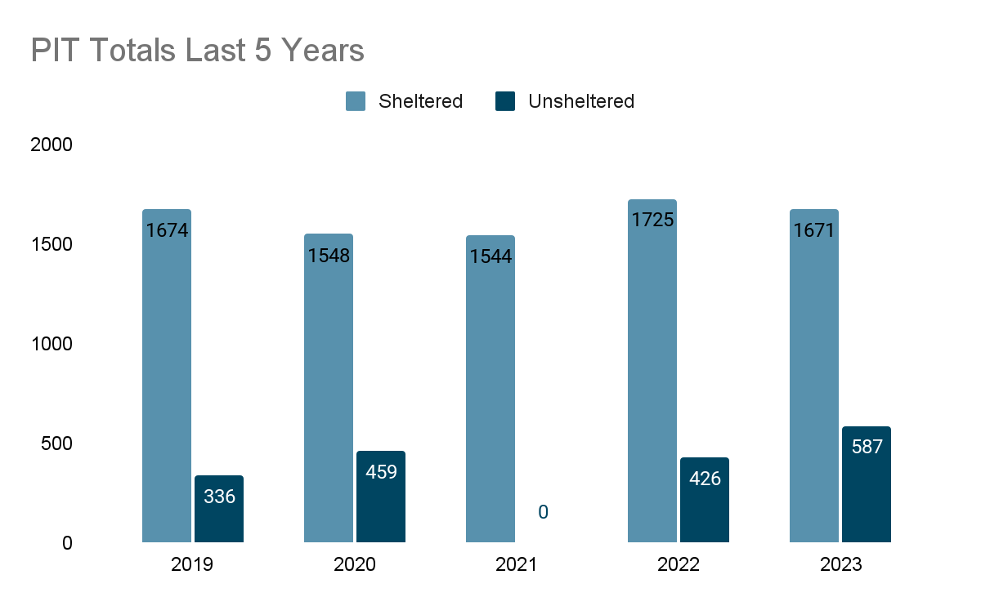
PIT 2023 Totals
The Point-in-Time (PIT) Count is a survey that collects estimates on the number of people experiencing homelessness on a single night in January.
Based on trends from the last 5 PIT counts, unsheltered homelessness has increased by 75%.
There were less people in shelter compared to last year, but overall shelter capacity has recovered since the start of the pandemic. Reductions in ESG-CV funding coincide with the reduction in number of people sheltered.
2010
2007
1544
2151
2258
*No unsheltered count
Notes:
Presenter: Brittney
Next Slide: Brittney

Slide 26
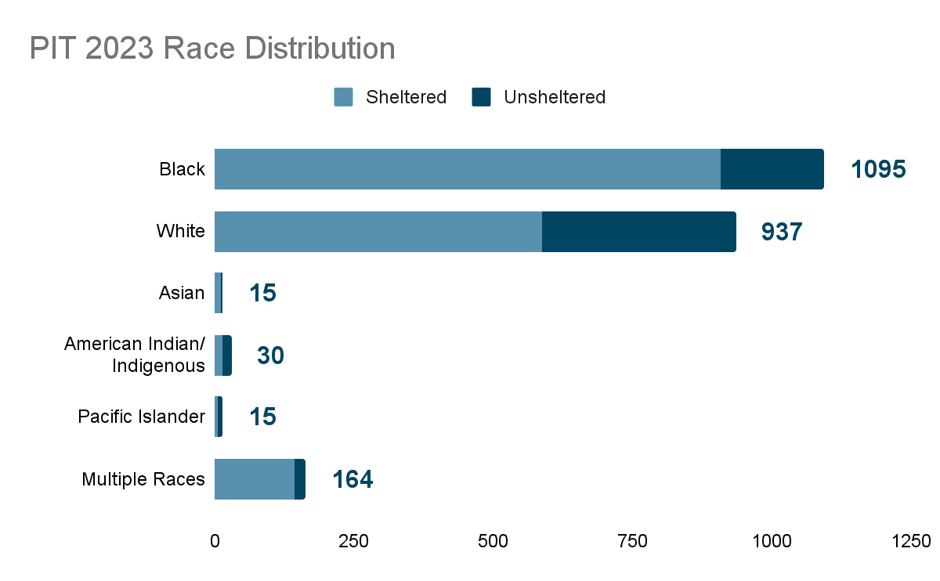
PIT 2023 Demographics
U.S. Census Bureau estimate of race breakdown for Orange County, FL (July 1, 2022):
White (67.6%)
Black (22.9%)
All Other Races (9.5%)
PIT Count 2023 (January 23rd, 2023):
White (41.4%)
Black (48.4%)
All Other Races (10.2%)
Almost 50% of people identifying as American Indian or Pacific Islander are unsheltered
Notes:
Presenter: Brittney
Next Slide: Brittney

Slide 27
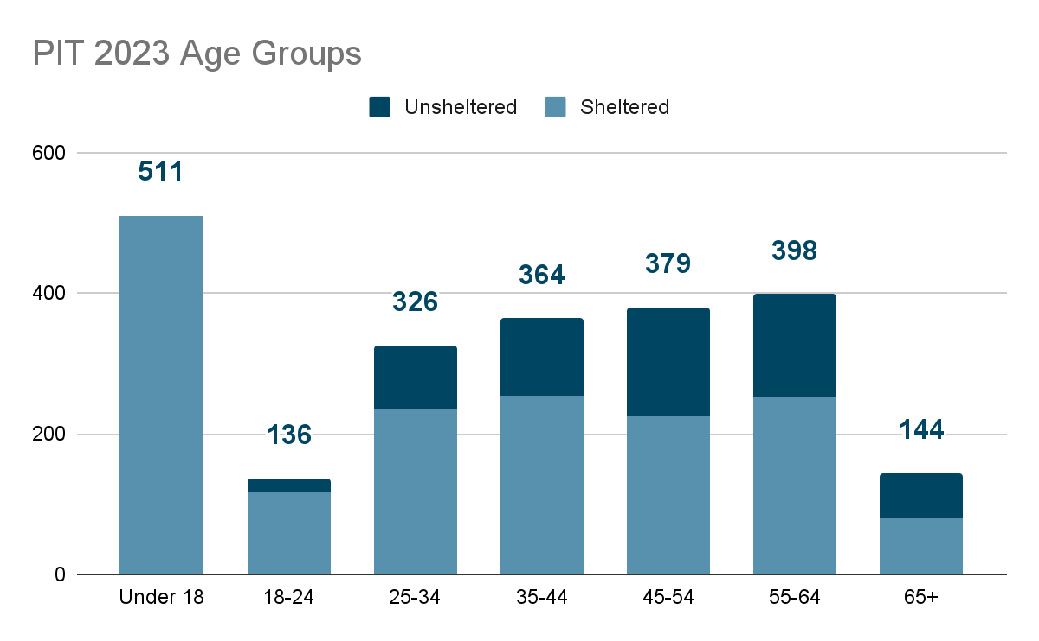
PIT 2023 Demographics
New Data Collection: Age Groups
99% of children under 18 were in shelter
44% of people over the age of 65 were unsheltered
Notes:
Presenter: Brittney
Next Slide: Brittney

Slide 28
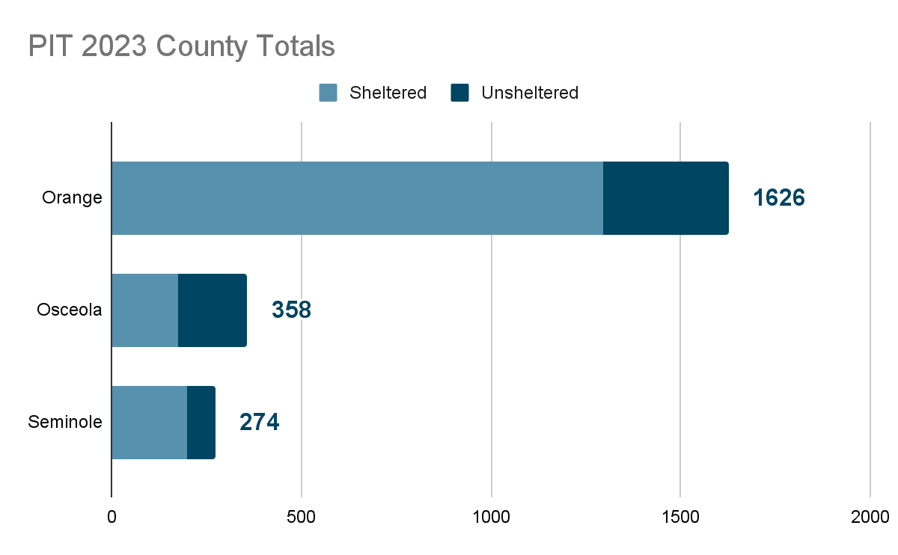
PIT 2023
Increase in homelessness by County:
Orange - 5% since 2019
Seminole - 8% since 2019
Osceola - 67% since 2019
Notes:
Presenter: Brittney
Next Slide: Brittney

Slide 29
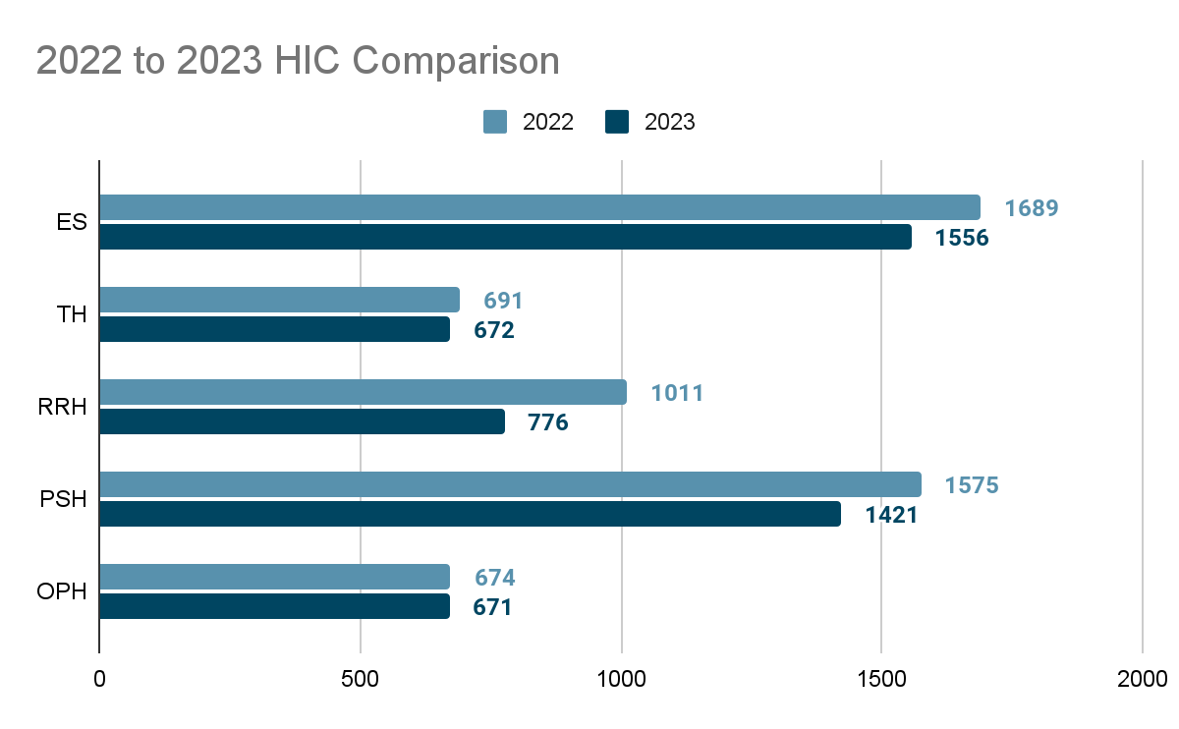
HIC 2023
87% utilization rate overall
Notes:
Presenter: Brittney
Next Slide: Angel

Slide 30
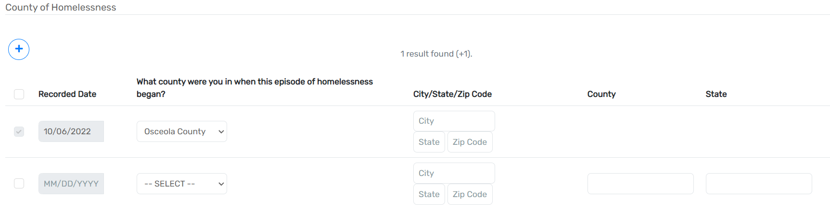
Proposed Changes to
County of Homelessness
Currently County of Homelessness is collected as part of the Client Intake in HMIS.
One-to-many relationship
  One client may have many County of Homeless entries in HMIS (with varying Recorded Dates).
Not required field
  Can be left blank when enrolling client into HMIS project.
Notes:
Presenter: Angel
Next Slide: Angel

Slide 31

Proposed Changes to
County of Homelessness
Propose to move County of Homelessness to the Enrollment
One-to-one relationship
  Each enrollment will have an associated
County of Homelessness entry
Set up as CoC FL-507 required data element
Apply only to Head of Household
Notes:
Presenter: Angel
Next Slide: Brittney

Slide 32
Data Standards Update
Launching on October 1st, 2023 - NEW Data Standards Updates
  Webinar with Eccovia on Wednesday - expectations and timeline
  Changes expected to the following fields:
    Race/Ethnicity
      Combining race and ethnicity questions into one field
      Impacts to APR/CAPER, any reporting utilizing race and ethnicity data
    Gender
      Updates to the gender response options terminology
    Social Security Number (SSN)
      For ESG, CoC, and PATH-funded projects: only required to collect last 4 digits of SSN, with the ability to collect a full SSN
      4-digit SSN is still considered “approximate or partial SSN reported”
      Unsure how this will be reported on future APR/CAPERs
    Coordinated Entry Activity
      Combing CE Assessment and CE Event
    Well-Being
      Removing from CoC-funded PSH project intakes
    Sexual Orientation
      Adding to CoC-Funded PSH project intakes
Notes:
Presenter: Brittney
Next Slide: Brittney

Slide 33

Referrals Discussion
ClientTrack Referral feature: enables users to make referrals for clients to other providers for services.
Differences with ServicePoint: In ServicePoint, a user could send a referral to any provider for any service that was available. In ClientTrack, visibility of referrals can be restricted.
Feedback
How do we want to approach setting up referral requests?
open system where everyone can send referrals to all providers?
restricted system where providers must agree to receive referrals between each other?
Notes:
Presenter: Brittney
Next Slide: Wyatt

Slide 34
Advisory Committee Elections
All Committee Members must be nominated and elected to Committee annually. Term is October 1 through September 30.
Committee Members may serve unlimited number of terms.
Committee Officers may serve two terms consecutively.
Nominations for members: July 1, 2023 - July 31, 2023.
Nominations for members accepted via hmis-advisory@hsncfl.org.
May be self-nominated or nominate another (must accept).
Elections held between August 1-20 (dates determined by committee)
All voting will be conducted virtually - all HMIS stakeholders may vote.
Officer nominations August 25-31. Elections by committee 2nd Tuesday in September.
Notes:
Presenter: Wyatt
Next Slide: Racquel

Slide 35
HSN University Training
The new, self-guided virtual HMIS 101 course in HSN University was officially launched on February 6th, 2023.
To date, we have around 25 successful course completions and several more in progress right now!
No more waiting for 1st and 3rd Tuesday to train
Audio and visual support all throughout
Complete conveniently on your own schedule
Support available via Live support hours and the Helpdesk
Live training still able to be scheduled as needed
Access to the live system provided 1-3 business days after requirements are met.
Requirements include:
  Completion of all required course modules;
  Demonstration knowledge in the practical portion of the training by completing required tasks/workflows in the HMIS training site;
  Review, sign and submit the HMIS User Agreement
Upcoming: Virtual courses for HMIS 102: SSVF, Street Outreach & PATH
Notes:
Presenter: Racquel & Tyler
Next Slide: Racquel

Slide 36

HMIS Training & Support
Our routine monthly training calendar:
1st & 3rd Tuesday: HMIS 101 New User Training (9a - 2p)
2nd & 4th Wednesday: HMIS 101/102 Refreshers (2p - 4p)
3rd Tuesday: ClientTrack Introduction to Reports Training (3p - 4:30p)
Ad-Hoc Reports Training (request via HMIS Support Ticket)
APR/CAPER in ClientTrack
Everyday Reporting in ClientTrack
Explore Data Explorer
Data Quality Workshop
Join us for our office hours M/W from 1p - 2p for additional one-on-one HMIS support.
Reminders:
All new user training requests must come through the Agency Liaison.
Agency Liaison needs to let the HMIS team know ASAP when someone leaves
the agency so we can inactivate accounts. This is to protect the system and keep an accurate count of available subscriptions for assignment.
Notes:
Presenter: Racquel
Next Slide: Raquel

Slide 37
HMIS Data Quality Monitoring
What to expect?
Data Quality Monitors Scheduled for 2023
  Communicated via agency liaisons
  Primarily focuses on the CoC APR/Data Quality Report
  We are looking at Q2 for FY22-23 (Jan - March)
  Supportive Service Only (SSO) project will now be reviewed as well.
Recommendations for improvements and a timeline for addressing data quality issues
Follow up with a scorecard (grading system)
Targeting agencies with projects that need a little “TLC” this quarter
Interested in sitting in on a DQM? Let us know at hmis@hsncfl.org!
Notes:
Presenter: Racquel
Next Slide: Ashley
Next Slide: Ashley

Slide 38
Changes to the Data Quality Plan (DQP)
Once per quarter data quality reports are pulled and data quality scores calculated (instead of monthly)
Targeted DQM invites have been sent to only those agencies who need data quality follow-up for Quarter 2 (instead of inviting ALL agencies)
Agencies are encouraged to pull data quality reports or APR monthly to review and correct data quality errors
Additional data quality support can be requested by sending a ticket to hmis@hsncfl.org
Notes:
Presenter: Ashley
Next Slide: Wyatt
Next Slide: Ashley

Slide 39
Breakout Rooms Discussion
What are things in ClientTrack that you find cumbersome, unclear, and/or could be better?
Are there any menu options in ClientTrack that you would like to learn more about, or have questions about?
Do you have suggestions for what you want to see/do differently in ClientTrack?
Are there parts of ClientTrack that you want to learn more about?
Have you needed additional support from colleagues, leadership, or HMIS staff to complete tasks? If so, what were the tasks?
Are you finding the layout and functionality of ClientTrack is enabling you to complete your duties in a more efficient manner? Why or why not?
Do you have any topic recommendations for upcoming HMIS Advisory Committee meetings?
Notes:
Presenter: Wyatt
Next Slide: Wyatt
Next Slide: Ashley

Slide 40
Committee Roll-Call Vote
HMIS Committee Officers
Notes:
Presenter: Wyatt
Next Slide: Wyatt

Slide 41
Committee Roll-Call Vote
Any other motion before committee
Notes:
Presenter: Wyatt -Open to motions by committee members
Next Slide: Wyatt

Slide 42
HMIS Advisory Committee Nominees
Accepting nominations (from supervisors, liaisons, peers, and self)
  Email hmis-advisory@hsncfl.org
    Include
      Name
      Agency
      Role with HMIS
      How long you have worked in HMIS
      Contact Email
      Contact Telephone Number
      Brief Biography
Voting on nominations will be done virtually
Please be sure that any person nominated is able to commit time to the committee and is willing to participate
Notes:
Presenter: Wyatt
Next Slide: Wyatt

Slide 43
Thank you for Attending!
Next meeting date:
Tuesday, July 11th, 2023
10:30 am to 12:00 pm
HMIS Guides, Documents, Training, Acronyms & More
hmiscfl.org
https://www.hmiscfl.org/training/datadefinitions/
Notes:
Wyatt Closes Meeting

Slide 44
HSN HMIS Team
Angel Jones
HMIS Operations Manager
Agustin “Tino” Paz
HMIS Senior Data Analyst
Ashley Brozenske
HMIS Data Analyst I
Brittney Behr
HMIS Project Coordinator
Chuck Vroman
HMIS System Success Specialist
Racquel McGlashen
HMIS Partner Success Specialist
Tyler Claitt
HMIS Partner Support Specialist

