Slide 1
HMIS Advisory
Committee Meeting
Central Florida Commission on Homelessness (CFCH)
CoC FL-507
March 8th, 2022
Wyatt Haro, Committee Chair

Slide 2
Agenda
HMIS Advisory Committee Purpose
HMIS Mission Statement
Nomination for Official Committee Vice Chair
Nomination for Official Committee Members
Committee Charter
Transition Updates
System Performance Measures
Gaither Dashboard Demos
Workgroup Updates
HMIS Training & Support
Q & A
Notes:
Call to order: Wyatt
Next Slide Wyatt

Slide 3
HMIS Advisory Committee Purpose
Oversee the CoC’s implementation of HMIS, what we do with the data and how we use it.
Notes:
Presenter: Wyatt
Next Slide:Wyatt

Slide 4
HMIS Advisory Committee Mission
Our mission is to effectively use data, which includes inputs from those in need of services, those providing services, and from members of the community, to eliminate homelessness in Central Florida.
Notes:
Presenter: Wyatt
Poll: Tino
Next Slide: Wyatt

Slide 5
HMIS Advisory Committee
Chair | Wyatt Haro | Miracle of Love
Vice Chair | Accepting Nominations (All Noms Accepted)
Secretary/Recorder | Accepting Nominations (All Noms Accepted)
Voting Member | Aleika Arboleta | Hope Helps
Voting Member | Brad Sefter | Health Care Center for the Homeless
Voting Member | Latoya Sheffield | Wayne Densch
Voting Member | Danielle Landaal | IDignity
Voting Member | ACCEPTING NOMINATIONS hmis-advisory@hsncfl.org
HMIS Team Liaison | Brittney Behr | HSN - HMIS Project Coordinator
Notes:
Presenter: Wyatt
Next Slide: Wyatt

Slide 6
Who can be a voting member?
Voting members are nominated (either by someone or themselves) and accepted by vote of the officers.
HMIS end-users
  Agency Liaisons
  Program Managers
  Case Managers
HMIS beneficiaries
  Clients
  Community Members
HMIS funders
Notes:
Presenter: Wyatt
Next Slide: Wyatt

Slide 7
Vacant Officer Posts
Committee Vice Chair:
Presides over HMIS Committee Meetings in the Chair’s absence
Onboards and manages committee members and structure
May act as Parliamentarian
Committee Secretary/Recorder:
Sends tentative meeting agendas to committee members
Drafts meeting minutes
Accepts and disseminates committee documents in final form
May act as Parliamentarian
Notes:
Presenter: Wyatt
Next Slide: Wyatt

Slide 8
HMIS Advisory Committee Nominees
Accepting nominations (from supervisors, liaisons, peers, and self)
  Email hmis-advisory@hsncfl.org
    Include
      Name
      Agency
      Role with HMIS
      How long you have worked in HMIS
      Contact Email
      Contact Telephone Number
      Brief Biography
Voting on nominations will be done virtually
Please be sure that any person nominated is able to commit time to the committee and is willing to participate
Notes:
Presenter: Wyatt
Next Slide: Wyatt

Slide 9
HMIS Advisory Committee Nominees
NOMINATION FOR VOTING MEMBER
  Danielle Landaal
    Program Director at IDignity
    I am passionate about making a lasting difference. Working at IDignity for the past 6 years, I've learned how we each within the CoC can help create a community surrounding our clients to not only serve their immediate needs, but to help equip them for a future of being supported and safe. I currently serve as Program Director of IDignity, where we assist individuals in obtaining legal proof of identity necessary for accessing basic needs like housing, healthcare, and employment.
Notes:
Presenter: Wyatt
Poll: Tino
Next Slide: Wyatt

Slide 10
HMIS Committee Charter
Adopted January 31, 2022
Can be accessed by anyone at: https://www.hmiscfl.org/hmis-advisory-committee-2/
Has been sent to Central Florida Commission on Homelessness
Notes:
Presenter: Wyatt
Next Slide: Brittney

Slide 11
Transition Updates
Next Stages with Vendor
Notes:
Presenter: Brittney
Next Slide: Brittney

Slide 12
Timeline Review
8.3.21
10.4.21
11.3.21
11.8.21
RFP Release
Vendor Demos
Vendor Demos
Recommend Vendor
The RFP was released publicly to all interested vendors.
Vendor demonstrations were held with a focus on administration and reporting.
Additional Vendor Demonstration focused around HMIS User experience.
We anticipate having a solid recommendation for the board.
11.15.21
1.1.22
6.1.22
Contract Negotiation
Begin Contracted Work
Launch
Negotiation with Apparent Successful Vendor
We estimate this time will begin the transition process
The highly anticipated launch of the new vendor software.
Notes:
Presenter: Brittney
Next Slide: Brittney

Slide 13
Current Projects
Set Up Data
  Organizations/Agencies
  Projects
  Grants
  Services
Training and Configuration
  Assessment forms
  Training on new software features
  Coordinated Entry
Extra Functionality Exploration
  Additional features related to Case Management
    Referrals
    Case Notes

Slide 14
How You Can Help
How can Agencies assist with the transition?
  Attend Data Quality Monitorings regularly
  Run APR’s and maintain high data quality
    Run APR’s on Agency-level too! Clients under agency-level project entries may not transfer over properly
  Provide information when requested on projects, grants, and services
  Keep us updated on changes
  Limit new requests for customized assessments or projects (unless required by funder)
Have questions? You can always submit a ticket!
hmis@hsncfl.org or use the blue “support” button at hmiscfl.org

Slide 15
Questions & Answers
For More RFP Information Visit:
https://hsncfl.org/funding
Notes:
Presenter: Brittney
Next Slide: Wyatt

Slide 16
System Performance Measures
FY20-21
Notes:
Presenter: Brittney
Next Slide: Brittney

Slide 17
What Are System Performance Measures?
System Performance Measures (SPMs) are a selection of metrics used to evaluate system-level performance
SPMs encourage communities to coordinate efforts across different projects and funding sources
SPMs are reported to HUD and are a competitive element in CoC Program Competitions for additional funding
SPMs focus primarily on how the whole CoC is performing, as opposed to specific projects or jurisdictions
Notes:
Presenter: Brittney
Next Slide: Brittney

Slide 18
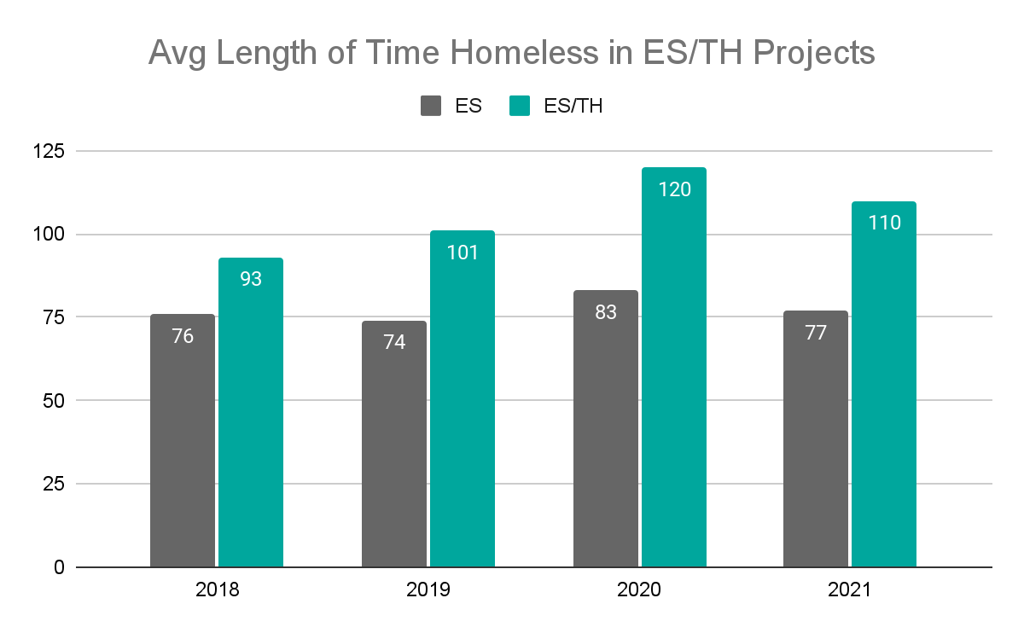
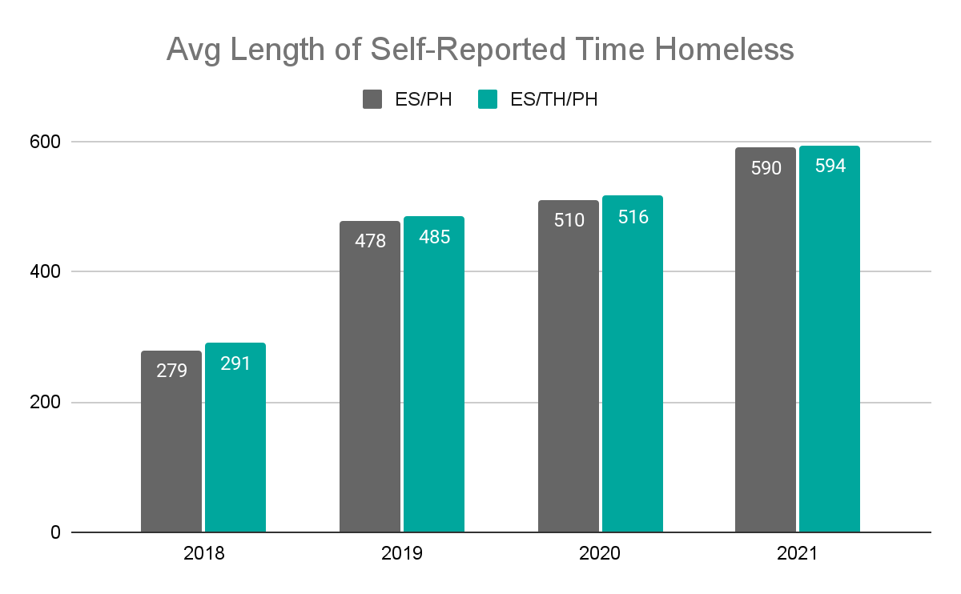
Measure 1: Length of Time Homeless
The average length of stay in Emergency Shelter projects has remained stable
Transitional Housing projects have experienced slight increases over time
Self-reported length of time homeless has increased
  This is due in part to non-congregate shelter options which target harder-to-serve populations that cannot access higher-barrier shelters
Notes:
Presenter: Brittney
Next Slide: Brittney

Slide 19
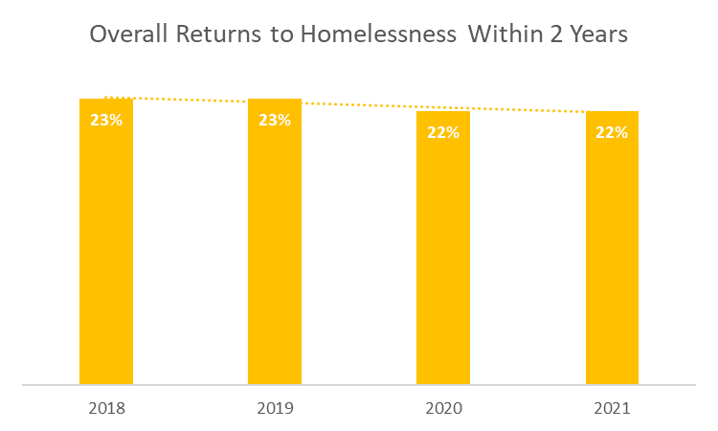
Measure 2: Returns to Homelessness
Returns to Homelessness within 2 years is trending slightly downward.
Notes:
Presenter: Brittney
Next Slide: Brittney

Slide 20
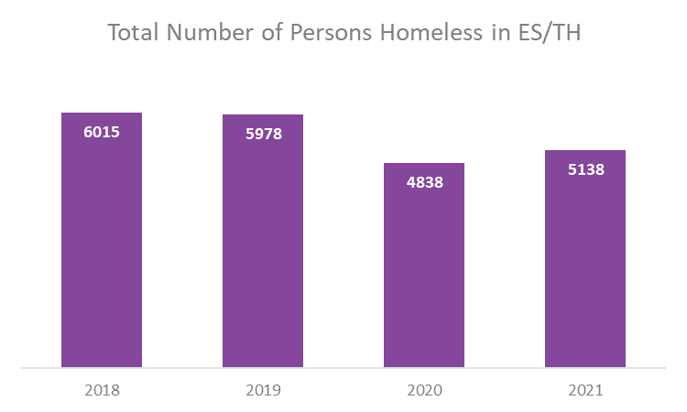
Measure 3: Number of Homeless Persons
Annual Count
The number of people experiencing homelessness in Emergency Shelters and Transitional Housing has decreased over time, this is likely due to capacity changes in response to the pandemic.
Notes:
Presenter: Brittney
Next Slide: Brittney

Slide 21
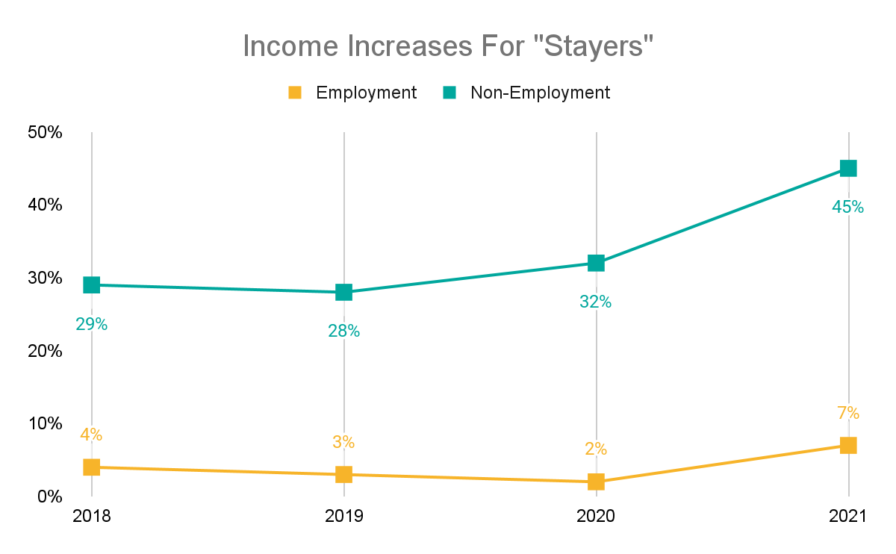
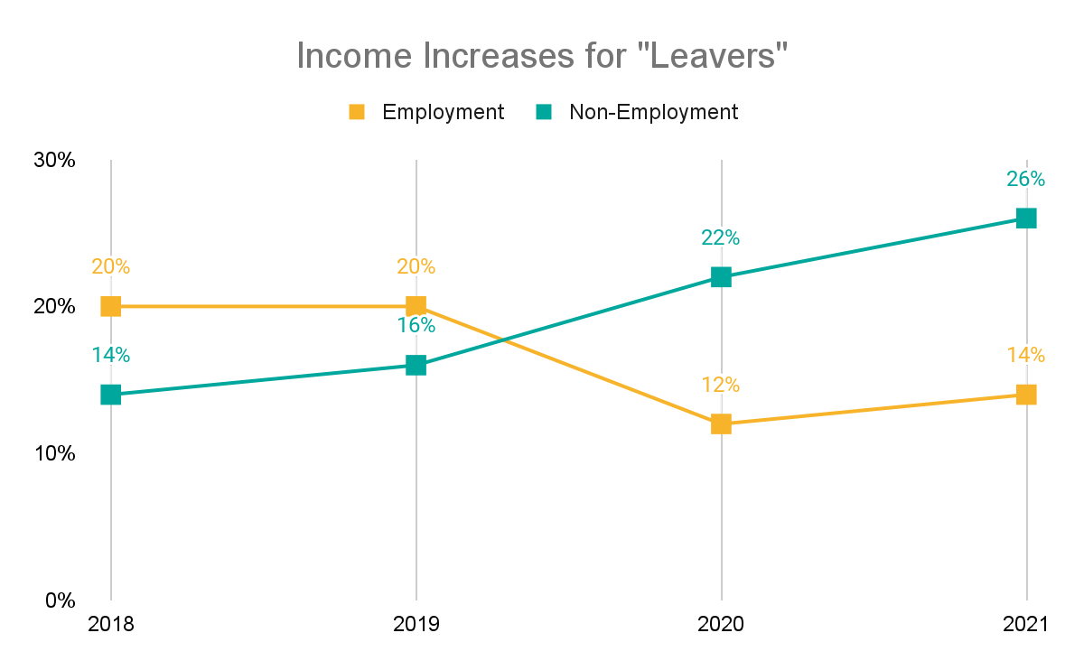
Measure 4: Increases in Income
“Stayers” are people still enrolled in RRH and PSH projects, 48% increased some form of income.
“Leavers” are people who have left RRH and PSH projects, 35% increased some form of income.
“Non-Employment” income is SSI, SSDI, TANF, and other resources.
HMIS coordinated efforts to improve the quality of data over time through training, refreshers, monitoring, and workshops.
Notes:
Presenter: Brittney
Next Slide: Brittney

Slide 22
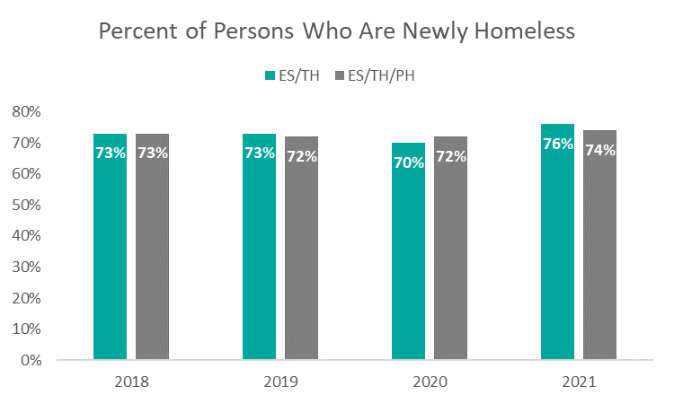
Measure 5: Number of Persons who Become Homeless for the First Time
Percentage Newly Homeless:
This is a proportion of the total persons served that are considered newly homeless
This measure has remained stable over the last few years, with a slight increase in 2021
first time.
Notes:
Presenter: Brittney
Next Slide: Brittney

Slide 23
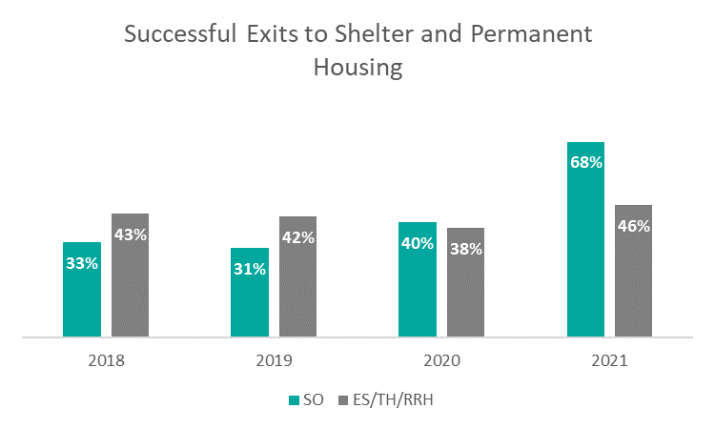
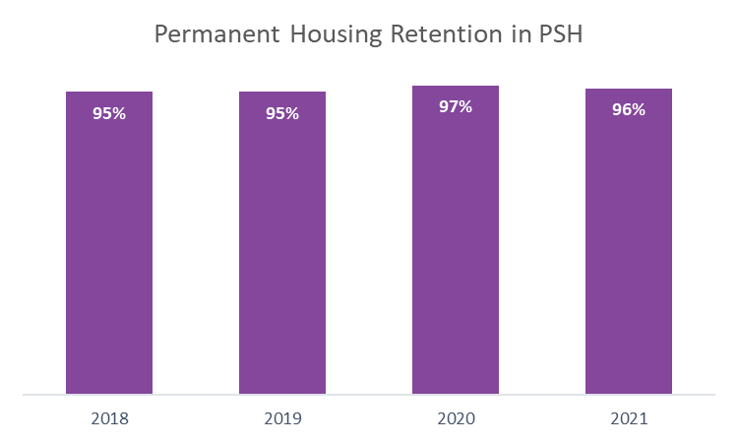
Measure 7: Permanent Housing Placement & Retention
SO Exits to Temp or PH:
34% exited to a temporary destination (such as shelter or an institutional setting)
23% exited to permanent housing
ES, TH, and RRH Exits:
Most permanent housing exits are from RRH
PSH Retention
Retention remained stable and high for PSH projects
Notes:
Presenter: Brittney
Next Slide: Brittney

Slide 24
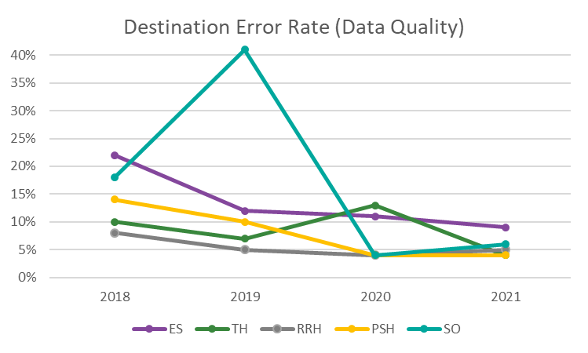
Data Quality 2018-2021
Destination Error Rate as a Measure of Data Quality:
All projects have a positive trend of data quality (lower error % over time)
Street Outreach projects have the most improvement
Notes:
Presenter: Brittney
Next Slide: Ashley

Slide 25
Gaither Dashboard Demos
Summary Dashboard
Notes:
Presenter: Ashley
Next Slide: Ashley
Summary Dashboard

Slide 26
Workgroup Updates
Data Quality Workgroup
Notes:
Presenter: Ashley
Next Slide: Ashley

Slide 27
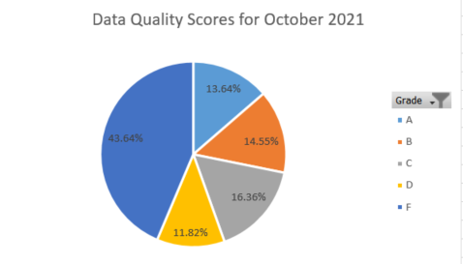
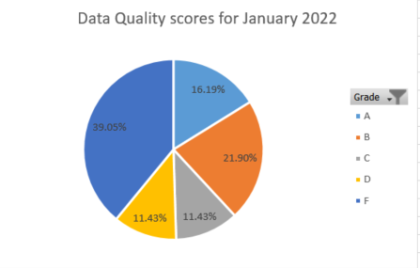
Data Quality Workgroup
Meets monthly on the third Wednesday of the month
Discuss data trends for the previous month
Develop mitigation strategies to reduce error rates
Meeting 2/16/22
  Discussed method behind developing data quality benchmarks and scoring (weight scale)
  Discussed overall CoC scores and data quality improvement
Notes:
As & Bs increased by nearly 10% since October. Fs decreased by nearly 5%.
Presenter: Ashley
Next Slide: Racquel

Slide 28
HMIS Training and Monitoring
Notes:
Presenter: Racquel
Next Slide: Racquel

Slide 29

HMIS Data Quality Monitoring
What to expect?
Data Quality Monitors Scheduled for 2022
    Communicated via agency liaisons
    Primarily focuses on the CoC APR
  Recommendations for improvements and a timeline for addressing data quality issues
  Follow up with a scorecard (grading system)
    Would like to publicize on our site
Interested in sitting in on a DQM? Let us know at hmis@hsncfl.org!
Notes:
Are there any members that are interested in sitting in on a Monitoring session?
Presenter: Racquel
Next Slide: Racquel

Slide 30
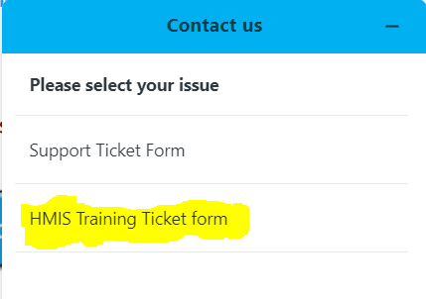
HMIS Training & Support
Updated training request form
Now, you can simply submit a New User training request by submitting a form directly on the Helpdesk. Select the option: “HMIS Training Ticket form”
Routine monthly sessions:
Every Tuesday: HMIS 101 New User Training (9a - 3:30p)
We returned to the original training schedule as of February (1st & 3rd Tues)
1st & 3rd Wednesday: HMIS 101/102 Refreshers
1st & 3rd Thursday: HMIS 101/102/103 Reports Training
* Additional training sessions may be requested as needed.
Join us for our office hours M/W from 1p - 2p for additional one-on-one HMIS support.
Reminder:
All new user training requests must come through the Agency Liaison.
Notes:
Presenter: Racquel
Next Slide: Wyatt

Slide 31
PIT Count Starts Today!
Thank you to all the volunteers.
Be safe.
Remember COVID protocols.
CDC County Community Level:
Orange: MEDIUM
Osceola: LOW
Seminole: MEDIUM
Notes:
Wyatt Closes Meeting

Slide 32
Thank you for Attending!
Next meeting date:
Tuesday, May 10, 2022
10:30 am to 12:00 pm
HMIS Guides, Documents, Training, Acronyms & More
hmiscfl.org
https://www.hmiscfl.org/training/datadefinitions/
Notes:
Wyatt Closes Meeting

Slide 33
HSN HMIS Team
Angel Jones
HMIS Operations Manager
Agustin “Tino” Paz
HMIS Senior Data Analyst
Ashley Brozenske
HMIS Data Analyst I
Brittney Behr
HMIS Project Coordinator
Chuck Vroman
HMIS System Success Specialist
Racquel McGlashen
HMIS Partner Success Specialist
Tyler Claitt
HMIS Partner Support Specialist

