Slide 1
HMIS Advisory
Committee Meeting
Central Florida Commission on Homelessness (CFCH)
CoC FL-507
July 13, 2021
Whitney Wiggins, Committee Chair

Slide 2
Agenda
Wyatt Haro, HMIS Advisory Vice-Chair
Official HUD Reports
  ESG-CV CAPER Updates
  HUD Informational
HMIS User Utilization
  Notes
  ResourcePoint Exploration
HMIS Training & Support
  New Training Workflow
HMIS Data Quality Monitoring and Reminders
  New HMIS Data Standards 2022 Released
Q & A
Exit Poll - What’s next for HMIS?
Notes:
Members email suggestions for the next committee meeting.(Whitney: wwiggins@covenanthousefl.org and Angel: )
Vote for a Vice Chair.
Official Voting Members. - How many do we need?

Slide 3
Official HUD Reports
ESG-CV CAPER
  3rd Round of Reporting is in progress due by 7/31/2021
  Next Qtr reporting period: 7/1/2021 - 9/30/2021
  Monthly Required & DQ Reporting is ongoing
Resources to Review ESG-CV Requirements:
*Only the HMIS Lead is responsible for uploading ESG-CV CAPER Reports.

Slide 4
Official HUD Reports
HUD Informational - HMIS Governance
  HUD has established guidelines for reviewing the effectiveness of the CoC HMIS Lead agency.
  Recently released documents that we can use to analyze HMIS Lead Agency effectiveness.
  Document Location:
    https://www.hudexchange.info/programs/hmis/hmis-guides/#hmis-leads-and-governance
  Review “HMIS Software Vendor Capacity Checklist”
  Questions?

Slide 5
HMIS Utilization
Our current HMIS tool includes many valuable features beyond the HUD requirements which agencies are using in many important ways.
Two important features are Notes & Referrals.
  Notes, notes and more notes!
    Highlight: Case Notes
    Other notes: a) Client notes, b) Service notes, c) Exit notes, etc.
  Referrals
    Coordinating with each other using ResourcePoint

Slide 6
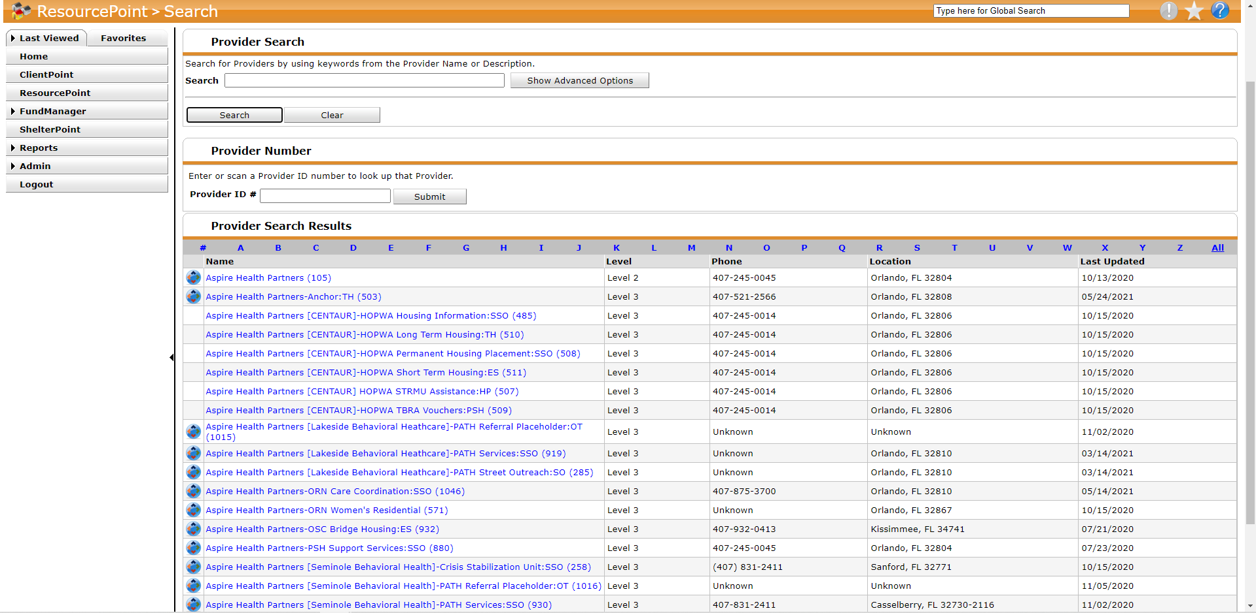
ResourcePoint Exploration
ResourcePoint is a provider database that contains a list of service providers in our CoC. Using this tool, you can locate providers based on their name, location, and services they provide.
Notes:
Though you may be familiar with ResourcePoint there seems to be confusion on what it is and how it can be used for our benefit. Simply put, ResourcePoint is a provider database that contains a list of service providers in our CoC. When properly updated and maintained this tool, can be used to locate providers based on their name, location, and services they provide. Additionally, ResourcePoint contains profiles on all these providers, allowing you to read about what they do, locate them on a map, and discover whether or not they are ServicePoint users. I want to clarify that the listed uses are only available to agencies in our CoC that have access to HMIS.
There are a few different ways to search for providers which include going through a list alphabetically, searching by name, and searching by eda. Other less familiar ways might include searching using a service code or Zip code. Once you find the provider you’re looking for, you can hover over the name for a quick view or click on the name to view their profile. This is where the updates that We’ve been trying to collect come in. Let’s take a look at a project with updated information, project 958
As you can see, this project was recently updated with things like a description of the specific project, contact information, location information, and service information. These elements are things that will allow other service providers to be well informed when the are referring new participants to a project. Unfortunately not all projects are as complete as this one. Let’s take project 1086 for example
This project doesn’t make it easy for someone who might be new to our CoC trying to refer a participant to another agency because there’s no description, nor any location information or service information. It only has one contact list which is not an ideal situation because if this person were to leave the agency we would not have a point of contact.
So as you might guess this is an important resource for everyone and it needs to be updated as much as possible and as soon as possible. We are developing another process to make submitting updates a little easier. For the meanwhile please continue to submit the resource point update form to myself or the hmis helpdesk with any updates that you have. If you have not yet submitted an update or need access to the form please contact me by submitting a ticket at hmis@hsncfl.org

Slide 7
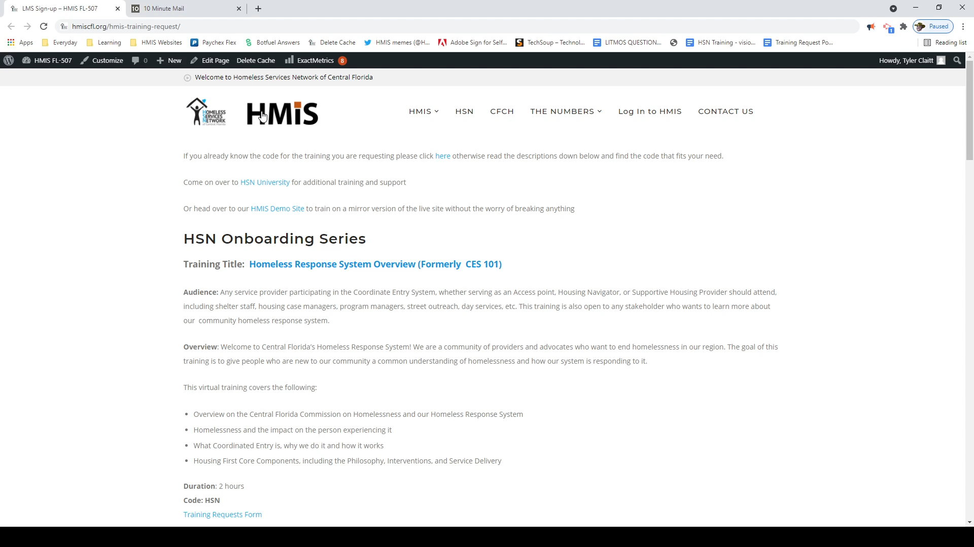
New Training Workflow
Go to the website and find the code that you need
Click on the Training request form link

Slide 8
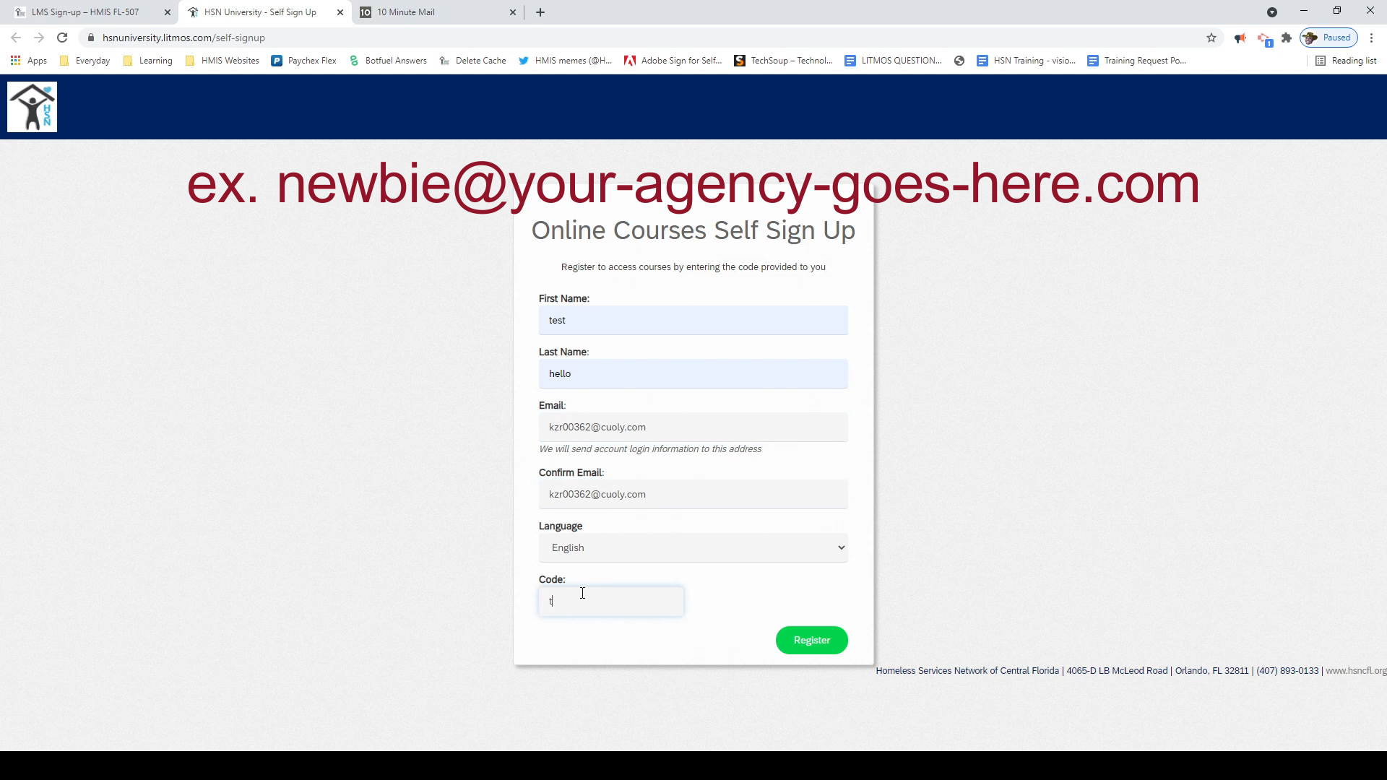
New Training Workflow
Fill out the Trainee’s information and input the correct code
Click register

Slide 9
New Training Workflow
Overview of the steps
Agency Liaisons
Go to the website and find the code that you need
Click on the Training request form link
Fill out the Trainee’s information and input the correct code
Click register
New Trainee
Find Email from HSN University (there should be two for new users)
Read the instructions and watched the attached video
Follow the link in the email and complete HSN University Profile
Open all assigned courses and complete and requirements for training sign up
Sign up for each assign training

Slide 10

HMIS Training & Support
Upcoming CoC-Wide Refresher Sessions (July/August)
*Invites will be extended to all applicable partners*
HMIS 102: RRH (for CMs)
Scheduled per agency
Required for all RRH CMs
  will address key areas that are contributing to poor data quality and measurement outcomes
Routine monthly sessions:
1st & 3rd Tuesday: HMIS 101 New User Training
1st & 3rd Wednesday: HMIS 101/102 Refreshers
1st & 3rd Thursday: HMIS 101/102/103 Reports Training
* Additional training sessions may be requested as needed.
Join us for our office hours M/W from 1p - 2p for additional one-on-one HMIS support.
Reminder:
All new user training requests must come through the Agency Liaison.

Slide 11
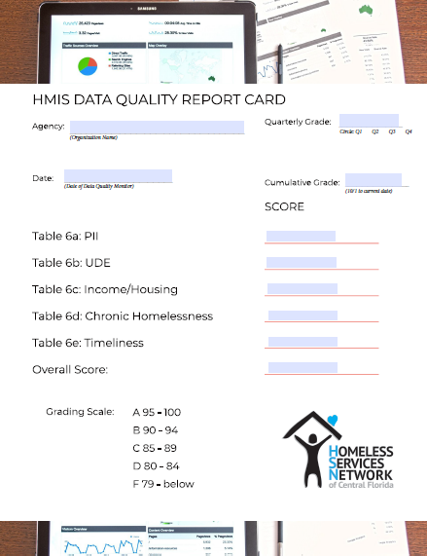
“HMIS Wellness Checks” aka
Data Quality Monitors
Why do we monitor?
Data compliance
Funding
Accurate storytelling
Who is involved?
Partnering agencies with at least one project in the HMIS
What does it involve?
Review of:
  CoC APR
  Project/User Set-up
  Custom reports
  Provider/Admin recommendations
New Calendy link will be sent out to ensure everyone is scheduled for the October DQM session and to allow everyone to select the next series of “HMIS Wellness Checks”. Moving in a GREAT direction!
Notes:
Are there any members that are interested in sitting in on a Monitoring session?

Slide 12
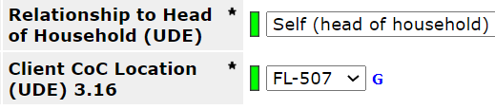
Data Quality in the CoC-APR
Data points with HIGH IMPACT on our system.
CoC APR Table 6b
Relationship to Head of Household - helps us associate for HUD (and other funders) the types of households experiencing homelessness in our federal reports.
All household members must have a selection.
Only ONE person is set as the HoH (Self)
Completed in the project entry assessment
Client Location - the FL-507 selection in each entry ensures that enrollment is associated with our CoC in federal reporting - complete for every person enrolled in a project.
Notes:
Ask Tino to jump in and provide an explanation - Wrangle em!

Slide 13
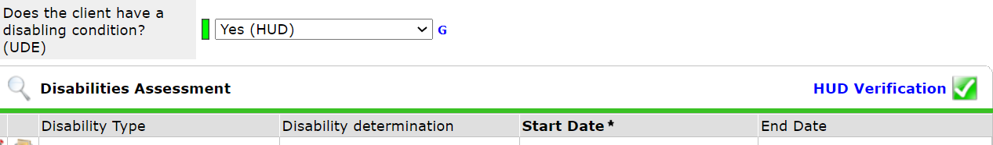
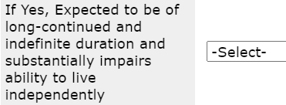
Data Quality in the CoC-APR
Data points with HIGH IMPACT on our system.
CoC APR Table 6b
Disabling Condition - a key data point that when paired with the housing questions in Table 6d allows the system to flag someone that is chronically homeless. Three parts to this workflow:
Yes/No
Disability sub-assessment
Additional question within the sub-assessment on severity per disability selected.

Slide 14
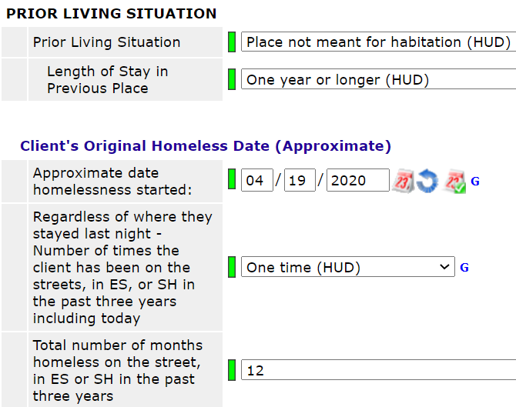
Data Quality in the CoC-APR
Data points with HIGH IMPACT on our system.
CoC APR Table 6d
Chronic Homelessness - these fields, paired with disability, identify who is chronically homeless in our system.
Prior living situation (current episode)
Length of stay (current episode)
Approx date homeless (current episode)
# of times homeless (3 years)
# of months homeless (3 years)

Slide 15

HMIS Data Standards 2022
New Data Standards announced
  Date effective: 10/1/2021
  Read more here!
Overview of changes:
  Wording changes for: Race, Gender, Ethnicity, Disability
  New multi-select options for Race & Gender
  New PSH data elements: Well-being
  Revised SSVF HP Targeting Screener
  Additional guidance: How to collect income & non-cash benefits for persons aging into adulthood
Notes:
wording change: more inclusive wording for race, ethnicity, and gender categories incl. the addition of “indigenous” to “Native American or American Indian”, the suffixes a/o/x to “Hispanic/Latino” & “Non-Hispanic/Non-Latino”, and the addition of the category “Questioning” to gender. These changes are in line with inclusion efforts by other federal agencies that allows our data to be comparable, such as the Census Bureau.
multiselect options: as another inclusion effort, users will be able to select multiple options for race and gender to better reflect the identities of the people they serve.
PSH data elements: New questions about well-being will be required at entry, annual assessment, and exit for CoC-Funded PSH projects. These questions are about a person’s perception of how they respond emotionally to challenges. The goal is that HUD will be able to see positive changes in a person's well-being as they progress in housing.
SSVF HP Targeting: wording has been changed to more general terms, so the HP targeting screener can be used for non-SSVF HP projects if desired
As we move through this process, HMIS will continue to send updates and reminders to help you move forward smoothly!

Slide 16
Other Data Collection Requirements
The following recommendations can help us to immensely improve our data quality across street outreach projects in our system.
Current Living Situation
  Sub-assessment found in the project entry/exit and in interim reviews.
  Should be recorded for every single contact made in Street Outreach
Interim Reviews
  Completed under the entry/exit tab
  Should be completed whenever participant provides an update on income, disability, insurance, non-cash benefits, DV status and housing status.
Coordinated Entry Collaboration
  Housing is the end goal. When individual decides to engage back resulting in deliberate assessments - they should be connected to CES. Contact Allison Nye to ensure you have the right tools in place for this connection to occur (allison.nye@hsncfl.org)
Project Exit Workflow
  Use the CoC APR to determine which participants have not had a contact recorded in HMIS in over 90 days. Exit those clients based on date of last contact.
For more information about the Street Outreach program and data collection and entry requirements, view a recording of our recent live training here or submit a ticket to our team at www.hmis@hsncfl.org

Slide 17
Questions or
New Topics and Issues
Please Complete
Exit Poll
Next meeting date:
Tuesday, September 14, 2021
10:30 am to 12:00 pm
HMIS Guides, Documents, Training, Acronyms & More
hmiscfl.org
https://www.hmiscfl.org/training/datadefinitions/

Slide 18
HSN HMIS Team
Angel Jones
HMIS Operations Manager
Agustin “Tino” Paz
HMIS Senior Data Analyst
Chuck Vroman
HMIS System Success Specialist
Racquel McGlashen
HMIS Partner Success Specialist
Tyler Claitt
HMIS Partner Support Specialist

